Slide 1


Automatic MS lesions segmentation in the spinal cord with CanProCo dataset
Nilser LAINES MEDINA - Polytechnique de Montréal

Slide 2
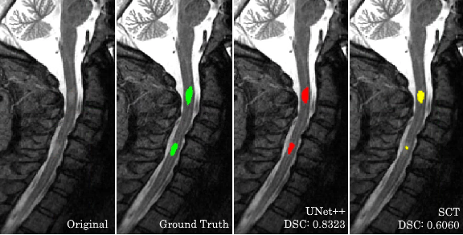
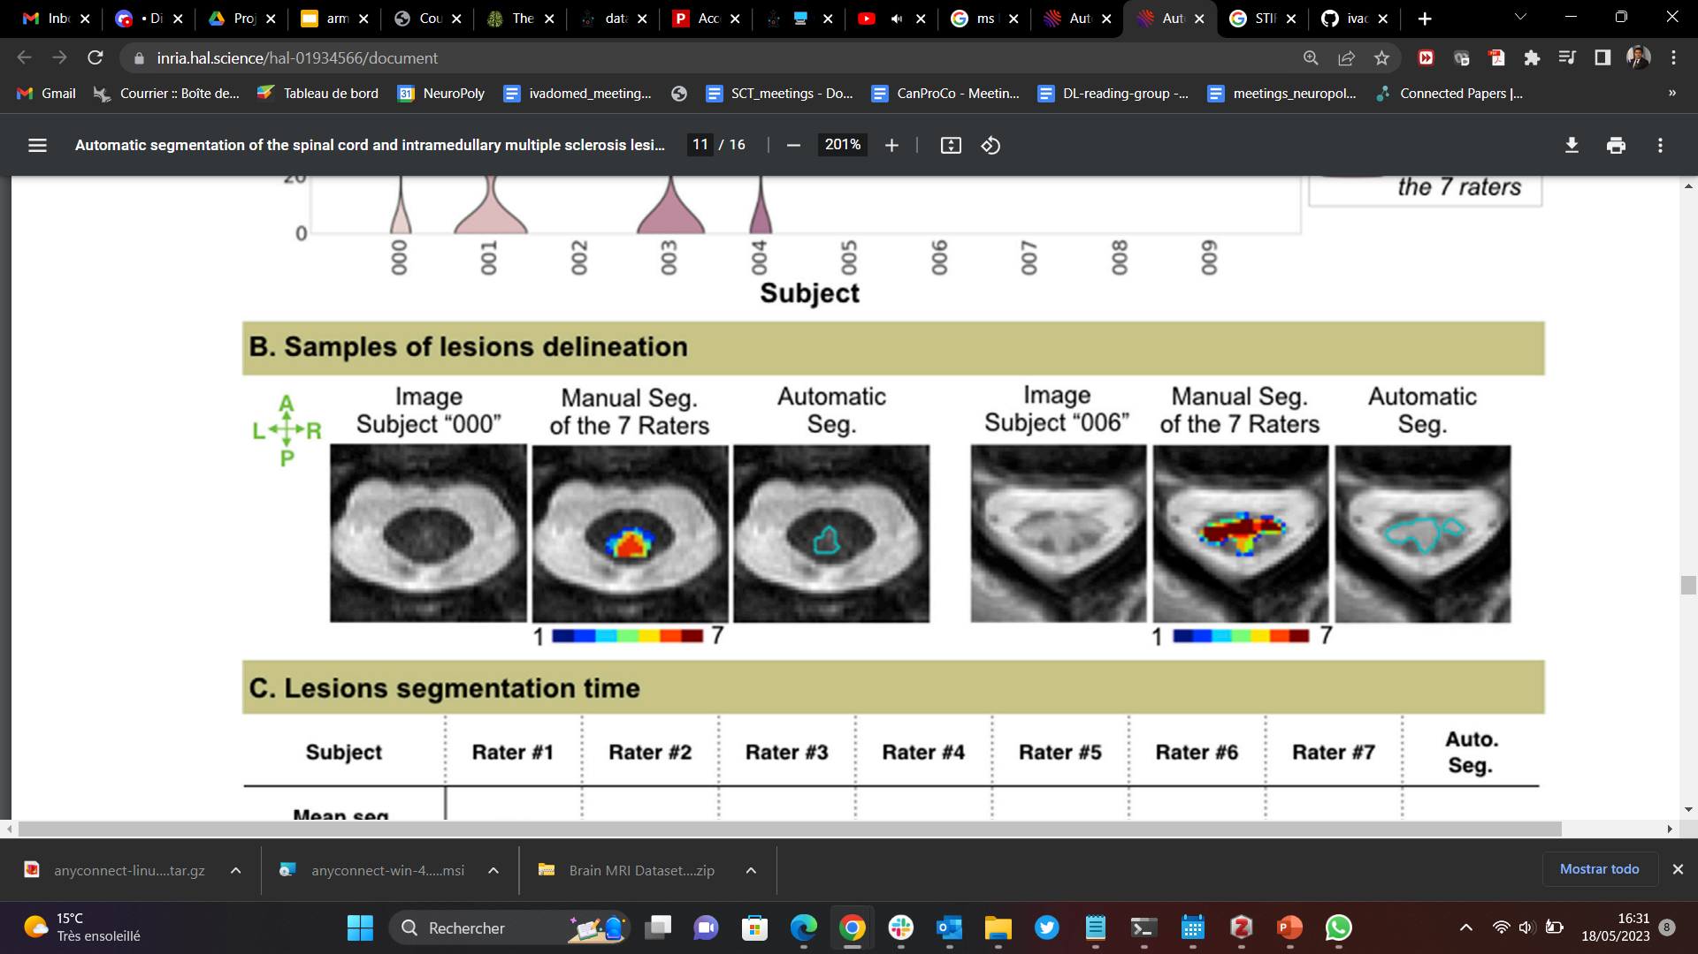
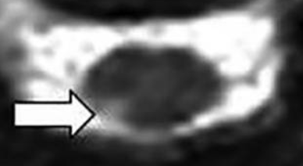
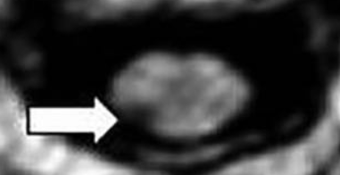
Background
MS is a disabling disease of the brain and spinal cord (SC). Characterized by presence of lesions [1][2][3]
Studies demonstrated the added value of 3T MP2RAGE sequence [5] and the advantages of 7T imaging [4][6][7][8].
Manual lesion identification is a slow process subject to inter-rater variability [9][10].
Automatic MS lesion segmentation in the SC has some initiatives [9][10][11].
[10]
[11]
3T MP2RAGE
Keep in mind!
Dice Score is affected by low pixel count [13]
=> Lesions have a small volume
Dice Inter-rater in the Brain MS lesions [12] = [0.59 - 0.69]
Dice Inter-rater in the Spinal Cord MS lesions [9] = 0.61
T1q UNI
[5]
[1] Lassmann et al., Cold Spring Harbor Perspectives, 2018; [2] Thompson et al., The Lancet. Neurology, 2018; [3] Sastre-Garriga et al., Nature Reviews. Neurology, 2020; [4] Dula et al., Multiple sclerosis, 2016; [5] Demortière et al., AJNR, 2020; [6] Ouellette et al., Brain, 2020; [7] Massire et al., ISMRM 2019; [8] Massire et al., NeuroImage, 2020; [9] Vincent et al., arXiv:2003.04377 [cs, eess], 2020;
[10] Gros et al., NeuroImage, 2019; [11] Hsu et al., ISMRM 2021 ; [12] Cerri et al., NeuroImage, 2021; [13] Shamir et al., bioRxiv 10.1101/306977, 2018
2

Slide 3


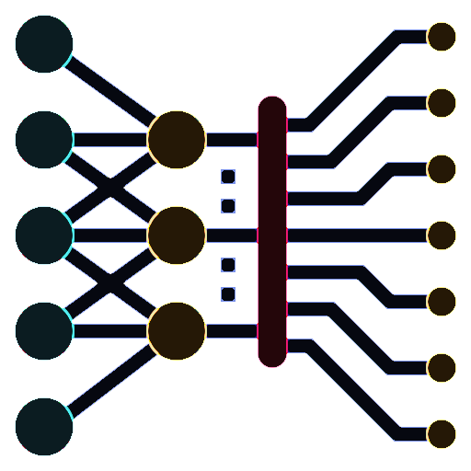


Objectives
Interact with CanProCo data
Provide a preprocessing pipeline for training/testing nnU-net [1] in the spinal cord.
Train segmentation models of MS lesions in the spinal cord.
Replicability test on MP2RAGE contrast (CRMBM, Marseille data).
To propose improvement paths for the automatic segmentation of MS lesions.
[1] Isensee et al., Nature Methods, 2021
3

Slide 4
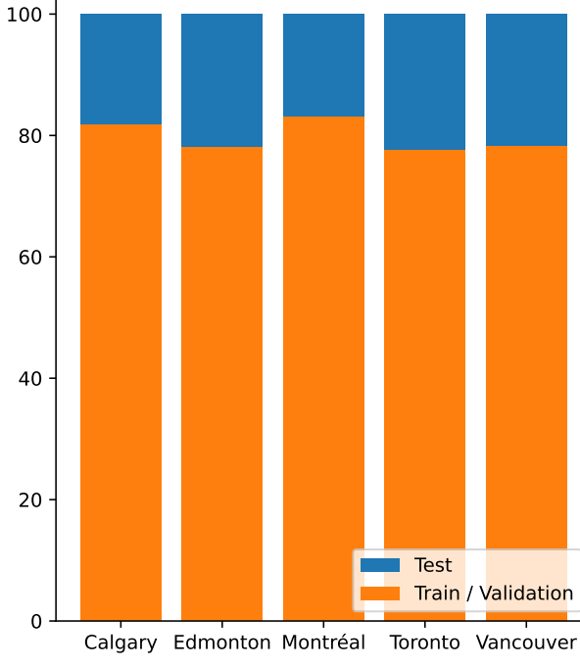
Data & Tools & Methods:
Pre processing: SCT, ivadomed Deep Learning: 2D nnUnet
Data analyse: Matplotlib, seaborn
CanProCo: Canadian Prospective Cohort study to understand progression in MS (HC=52, MS=393) [STIR+Lesion Interactive]
Center | Sementation | PSIR | STIR | T2w | Total
Calgary | Lesion |  | 82 |  | 82
 | Spinal Cord |  |  | 82
Edmonton | Lesion | 59 |  |  | 59
 | Spinal Cord |  |  | 59
Montreal | Lesion | 94 |  |  | 94
 | Spinal Cord |  |  | 94
Toronto | Lesion | 80 |  |  | 80
 | Spinal Cord |  |  | 80
Vancouver | Lesion | 78 |  |  | 78
 | Spinal Cord |  |  | 78
Total |  | 311 | 82 | 393
Train/validation/test splits
20%
CV: 5 folds
Fold_00
Fold_01
Fold_02
Fold_03
Fold_04
80%
4

Slide 5
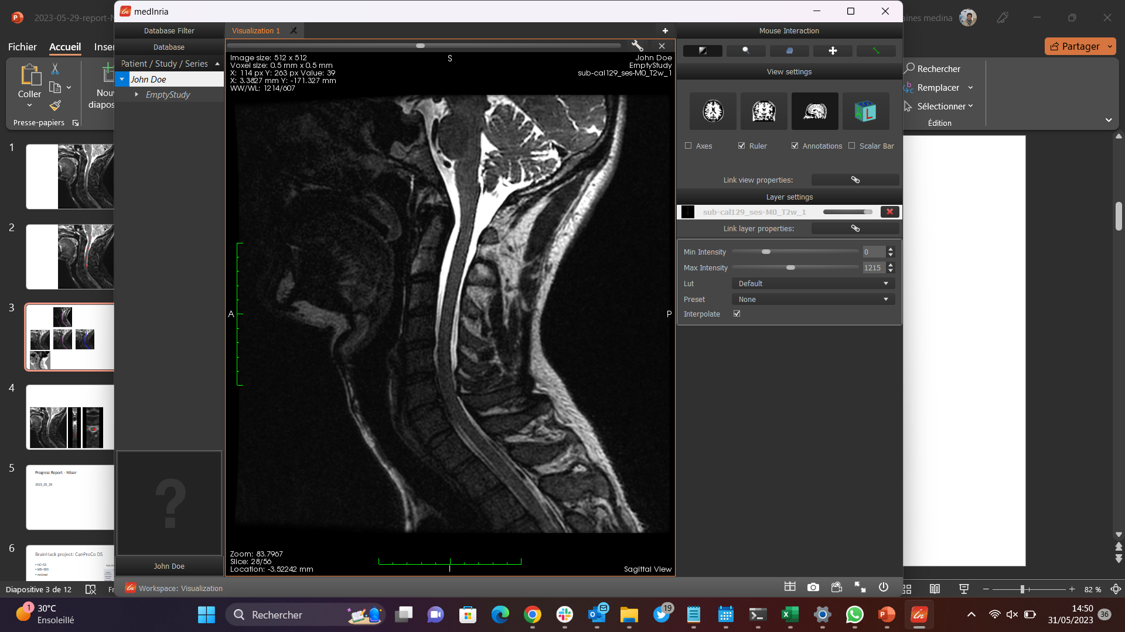
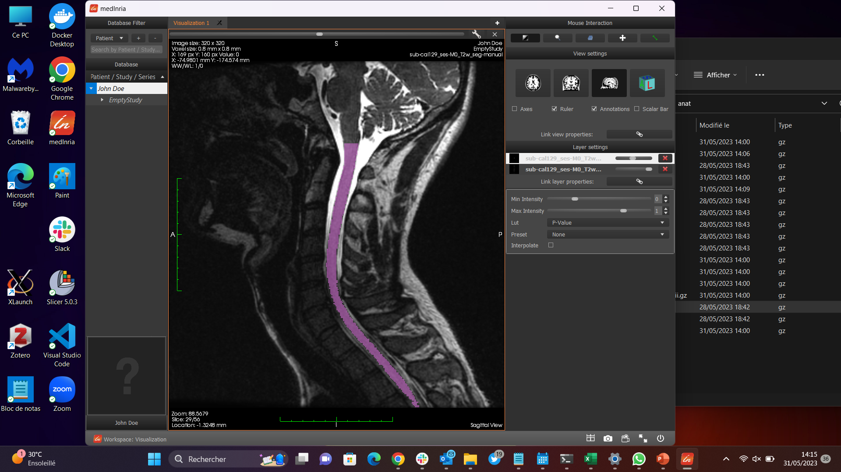

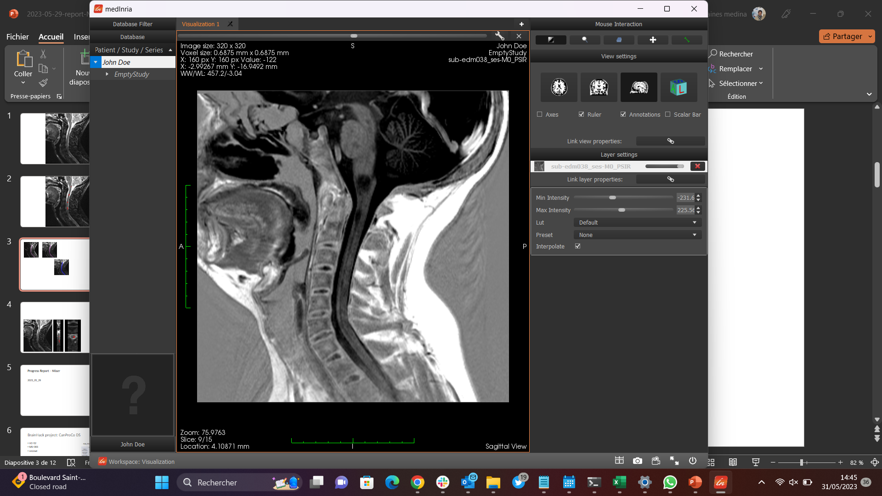

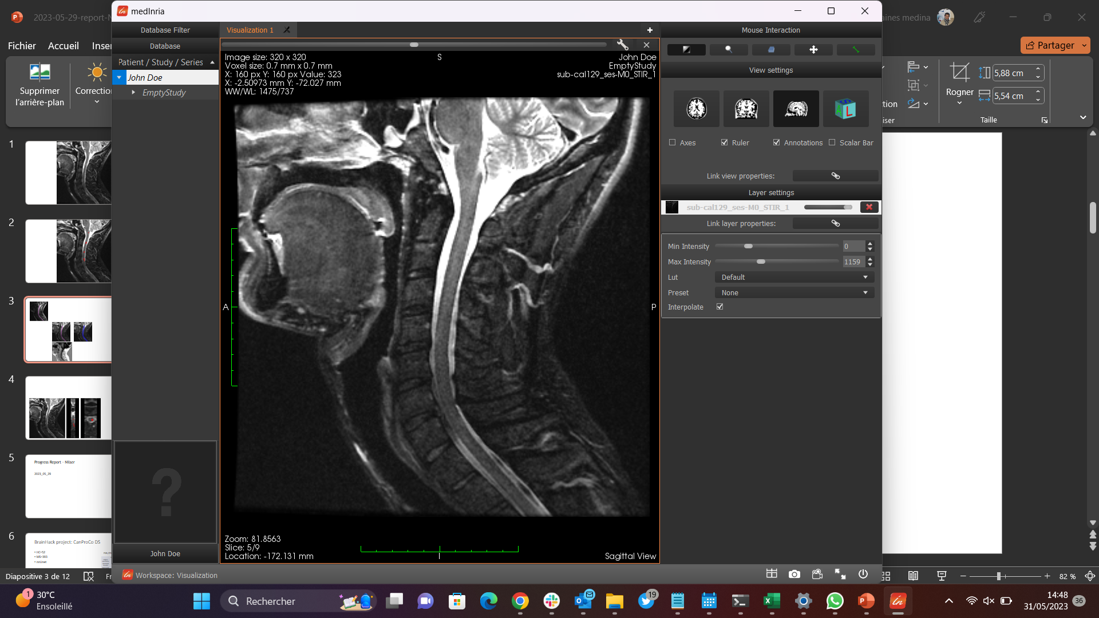
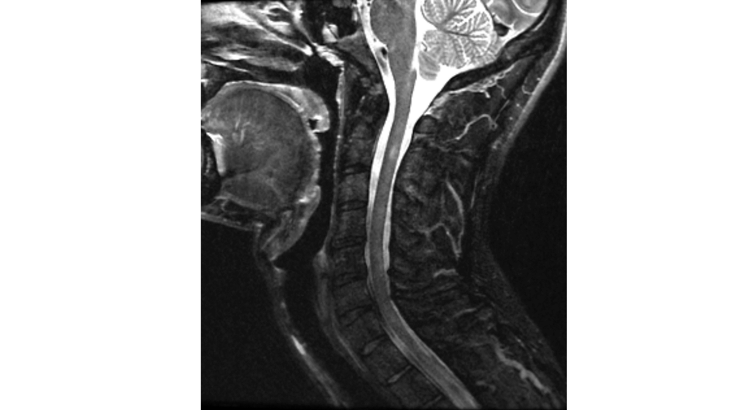
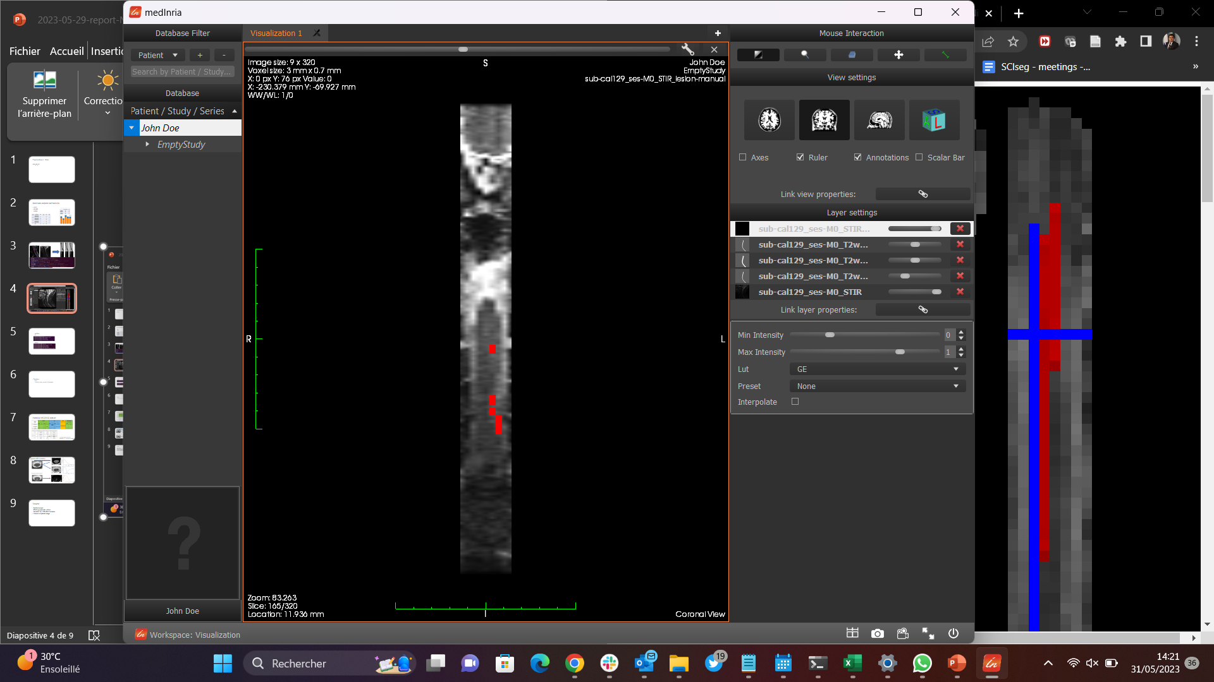
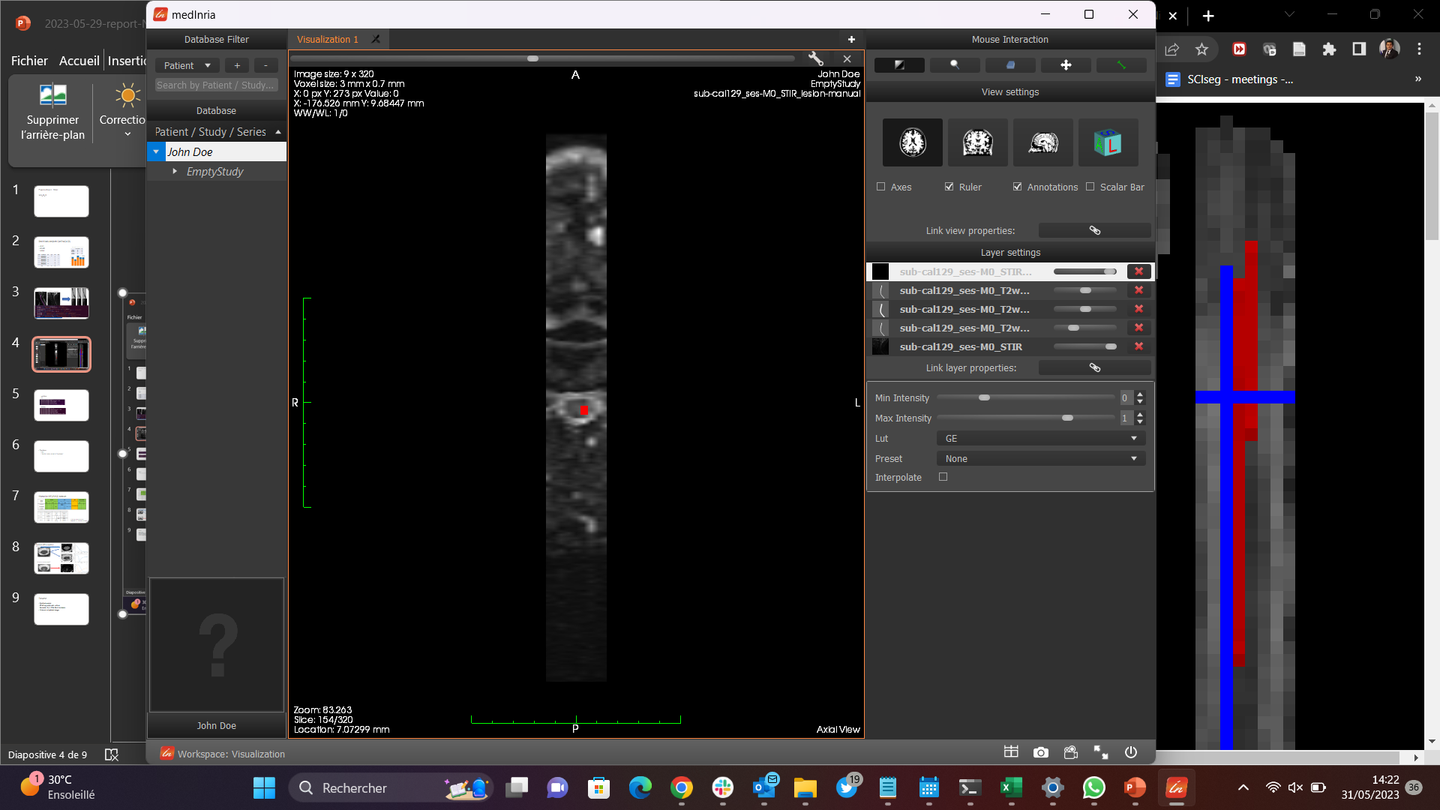
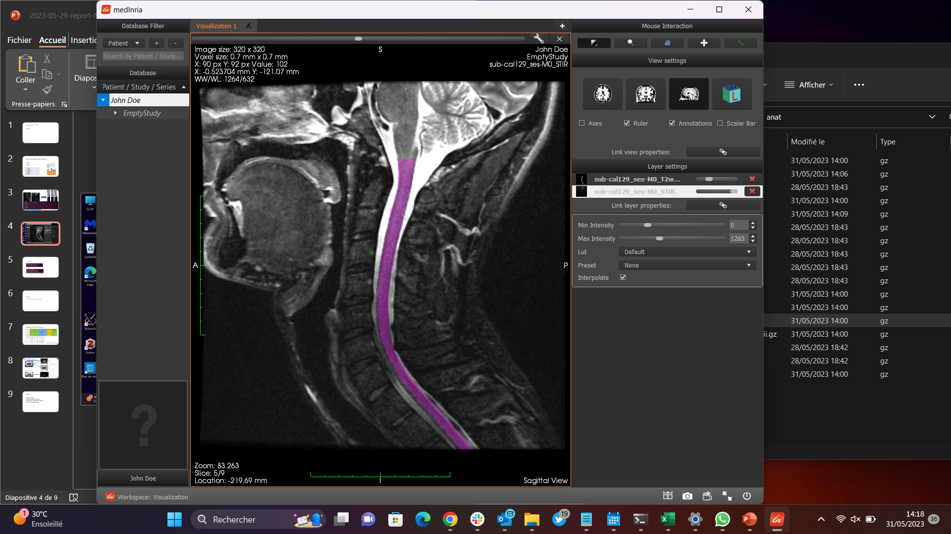
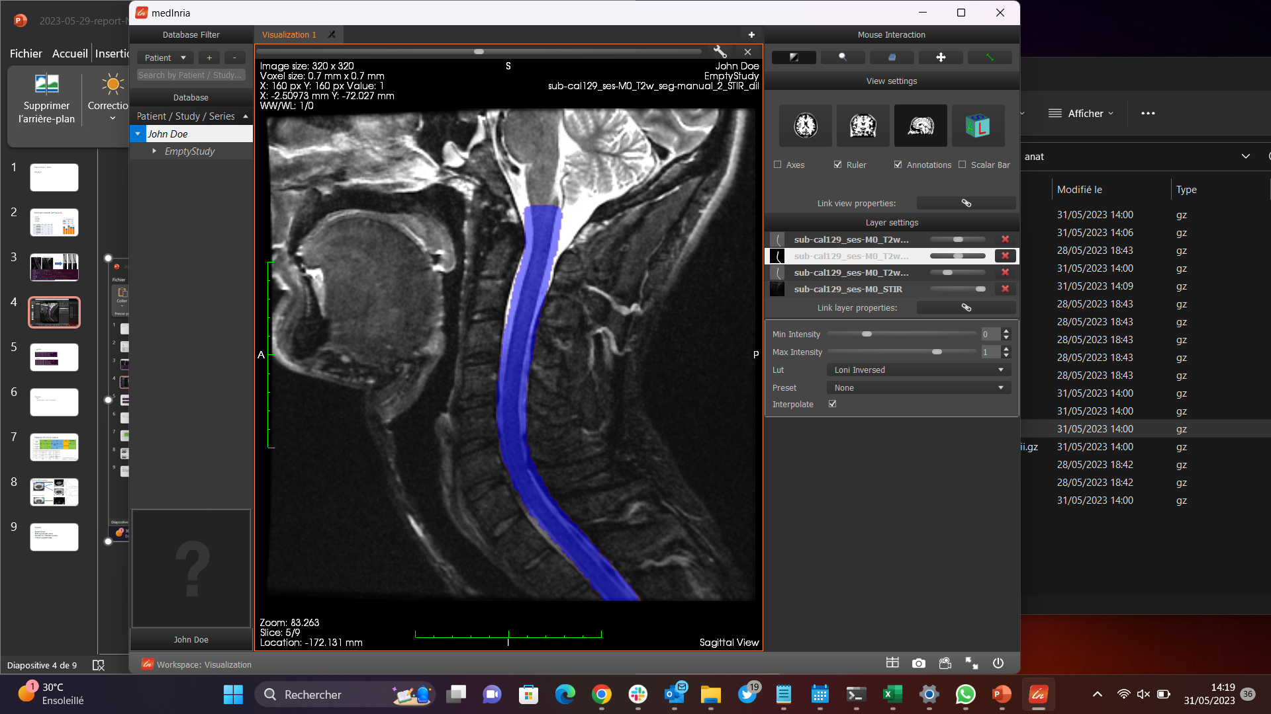
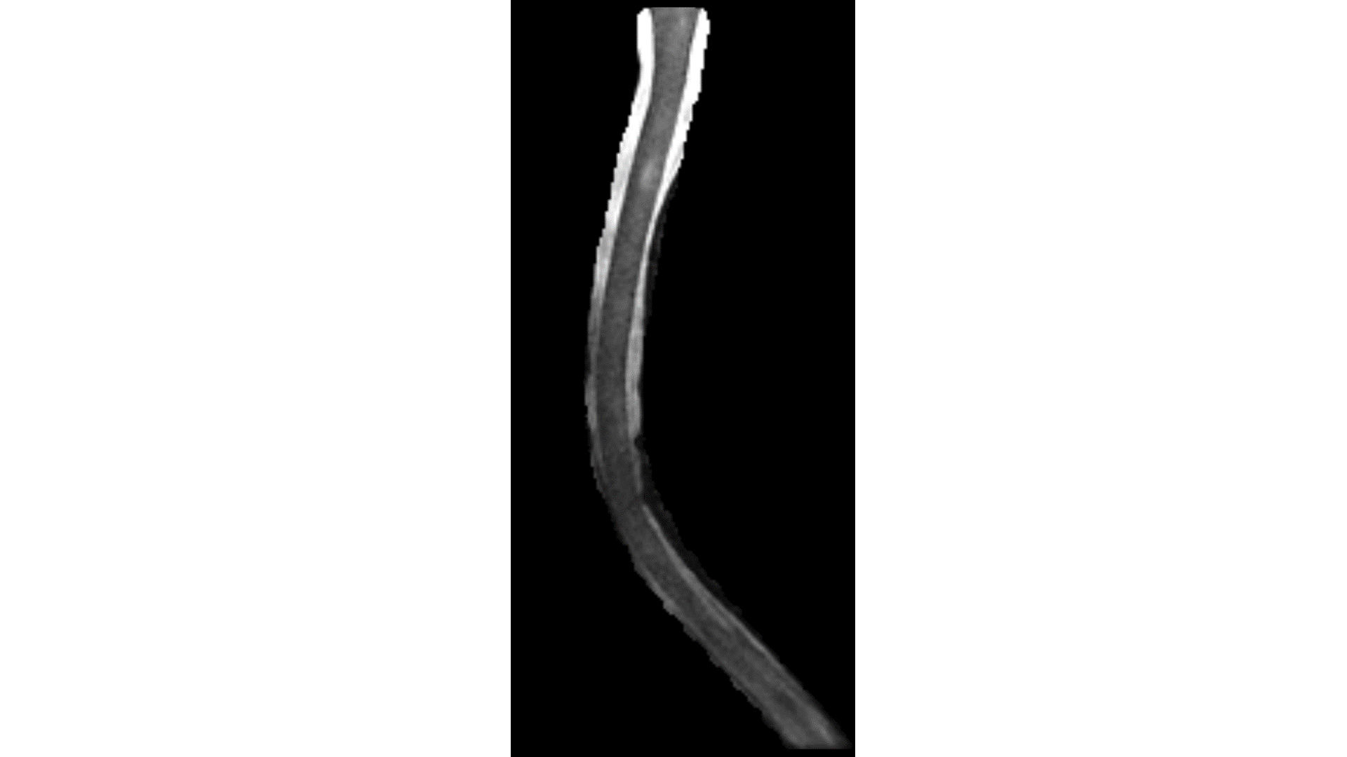

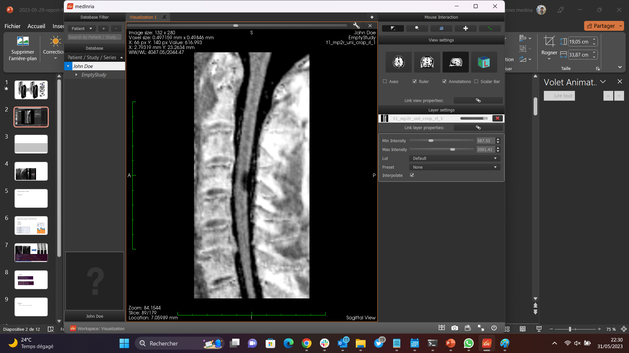
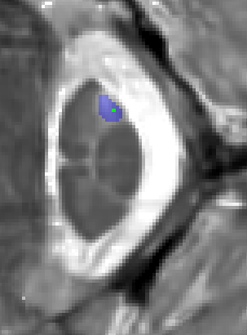
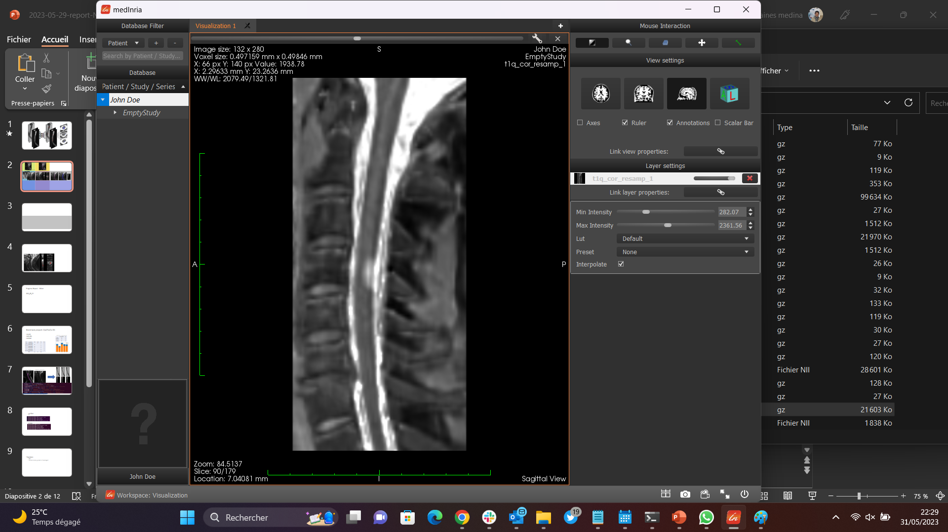
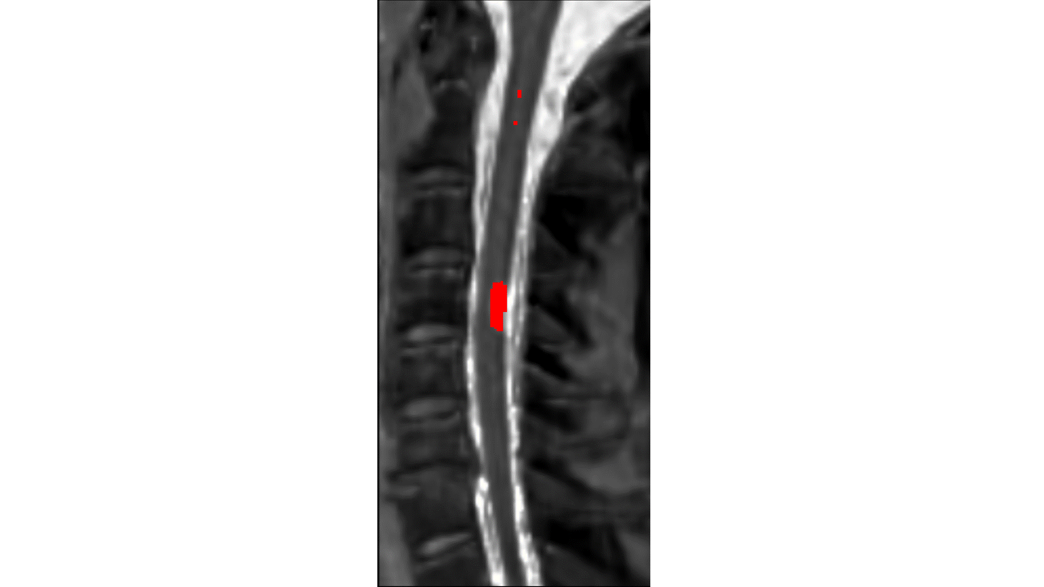
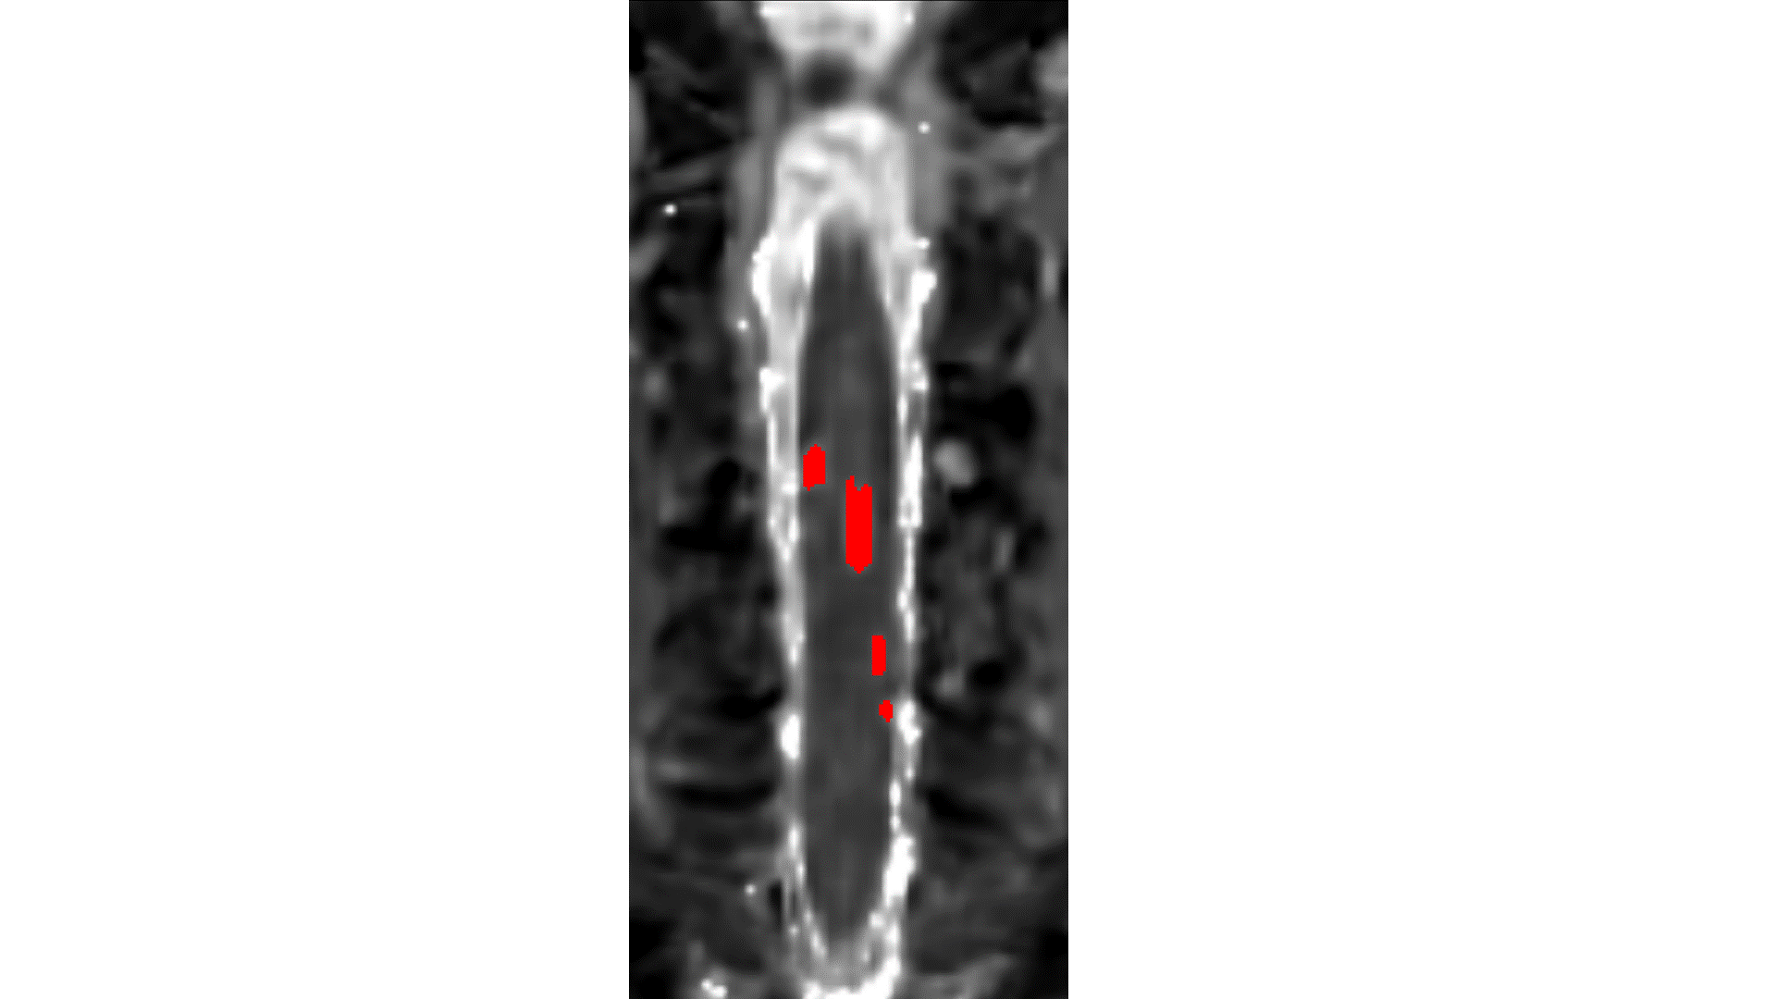
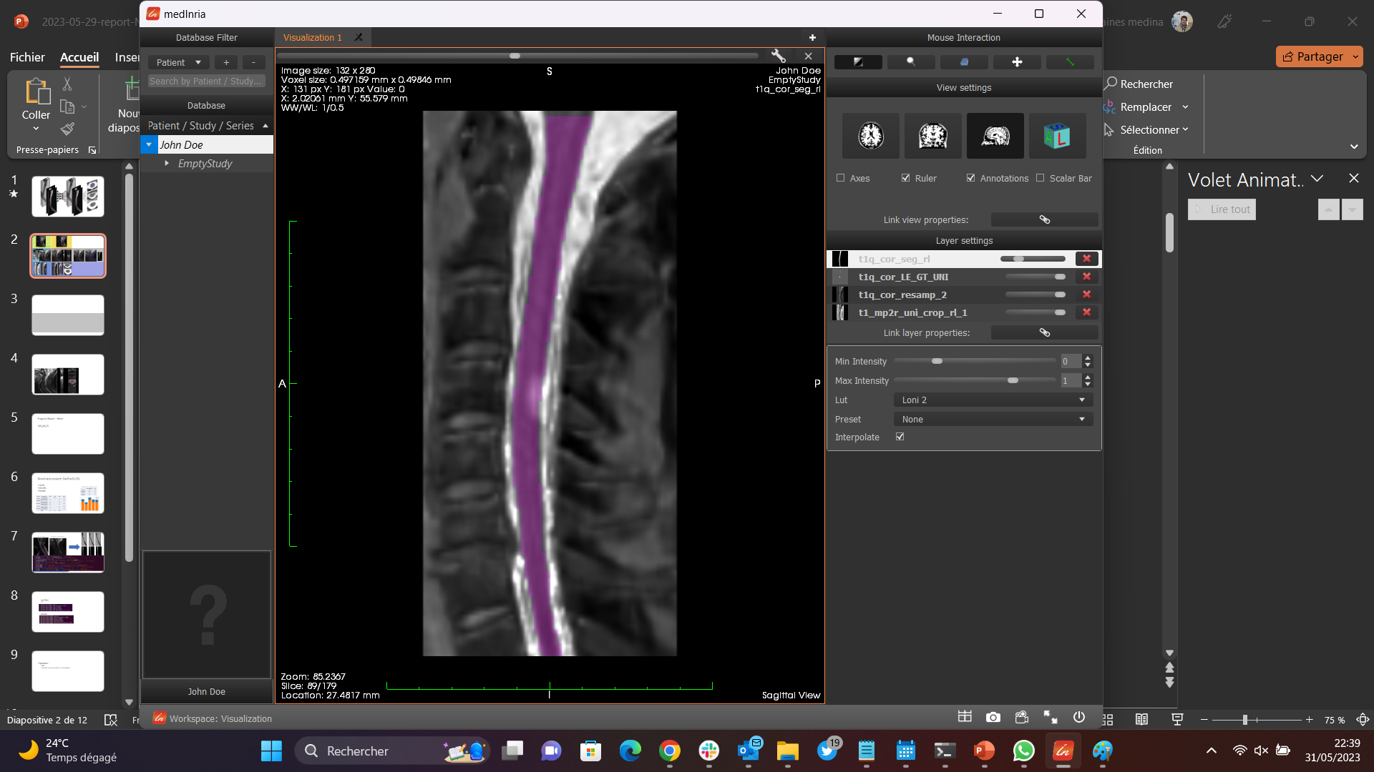
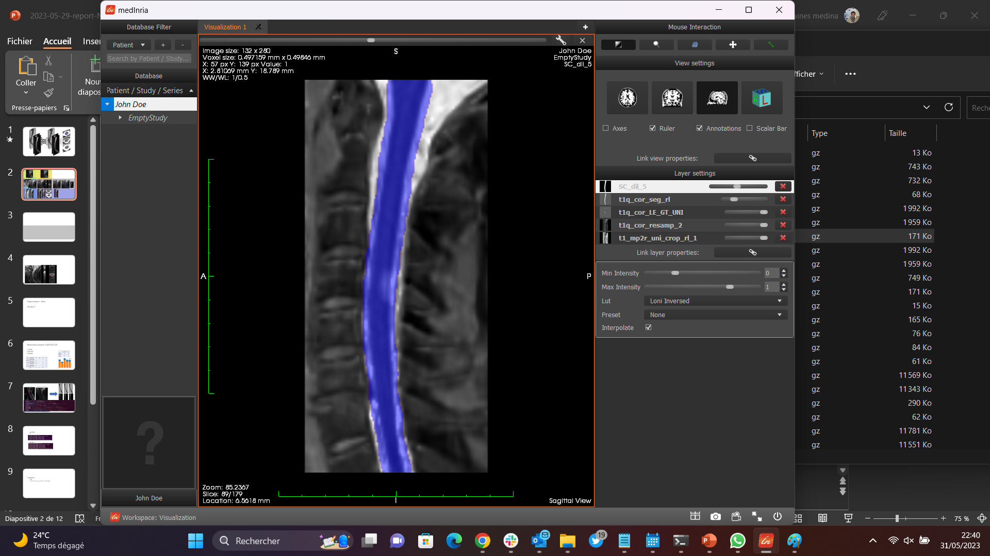

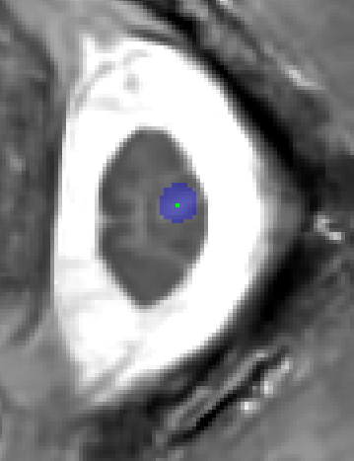
Pre-processing Pipeline
Reorient to RPI and resampling
T2w SC mask to PSIR/ STIR registration
SC registered masks dilation for include CSF
PSIR / STIR cropping in SC shape
PSIR / STIR and lesion images masking with SC dilated for training
T2w
r=(8 x 0.5 x 0.5)
CanProCo dataset
r=(3 x 0.7 x 0.7)
PSIR
STIR
Why this data was suitable for your research question?
3T / 7T MP2RAGE
CRMBM
7T
UNI
T1q

Slide 6
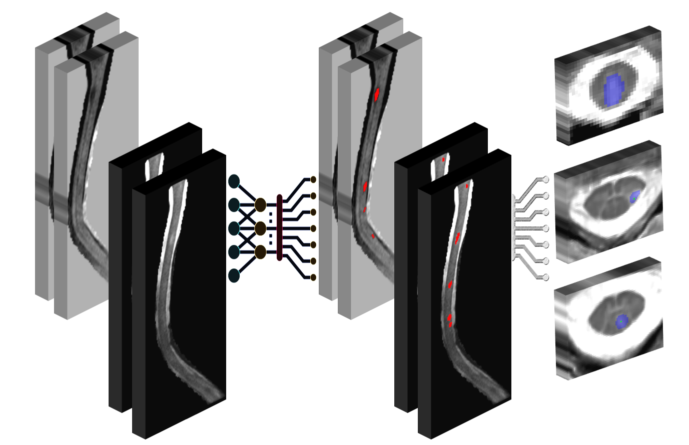
Results

Slide 7
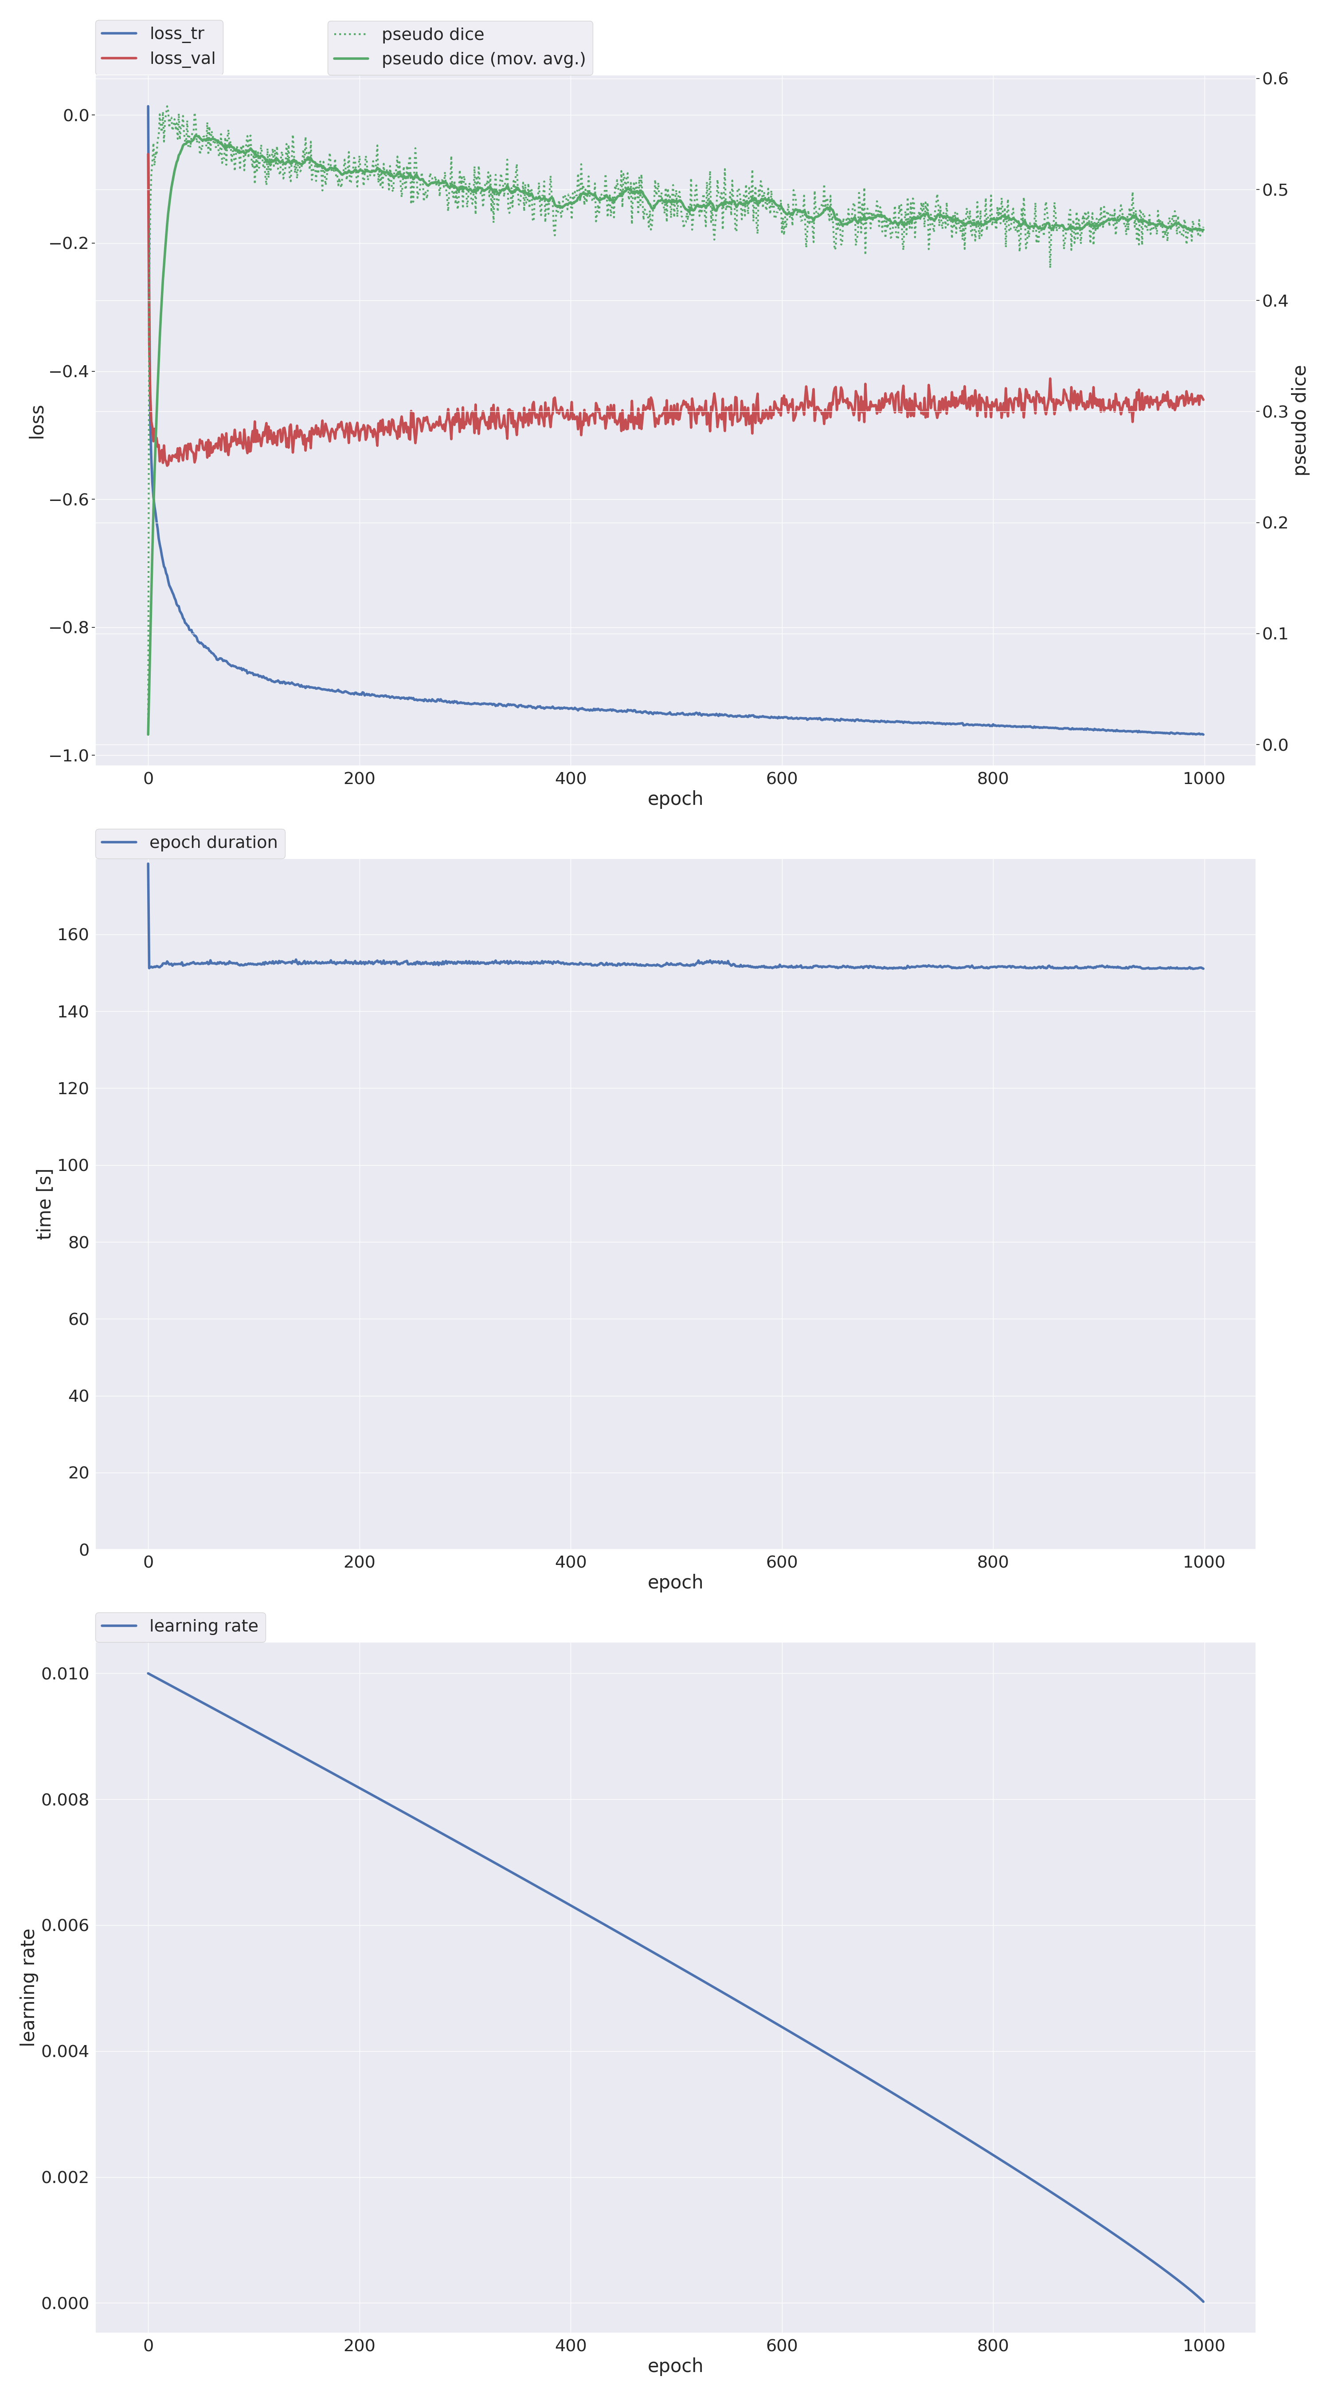
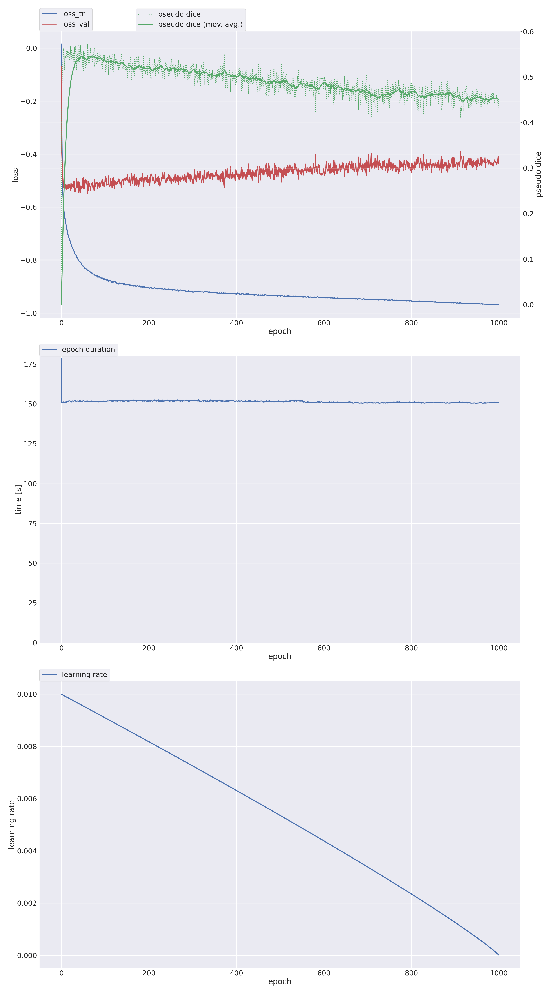
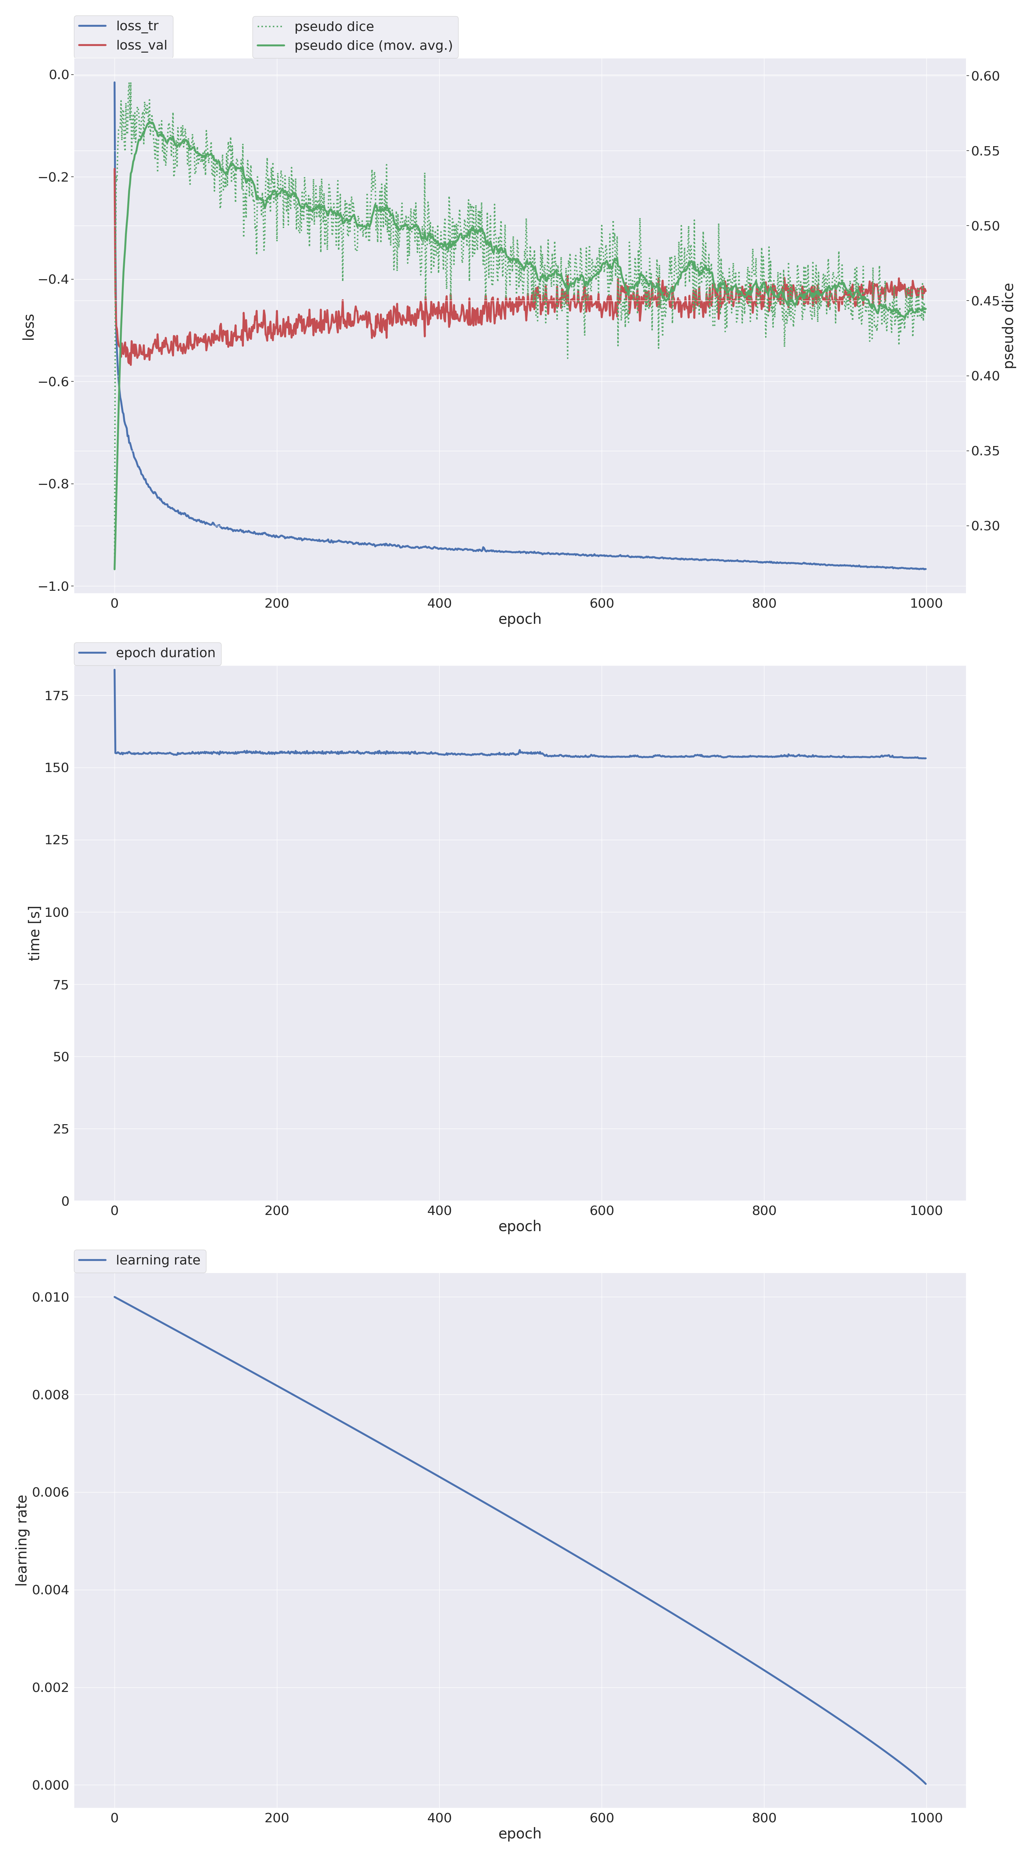
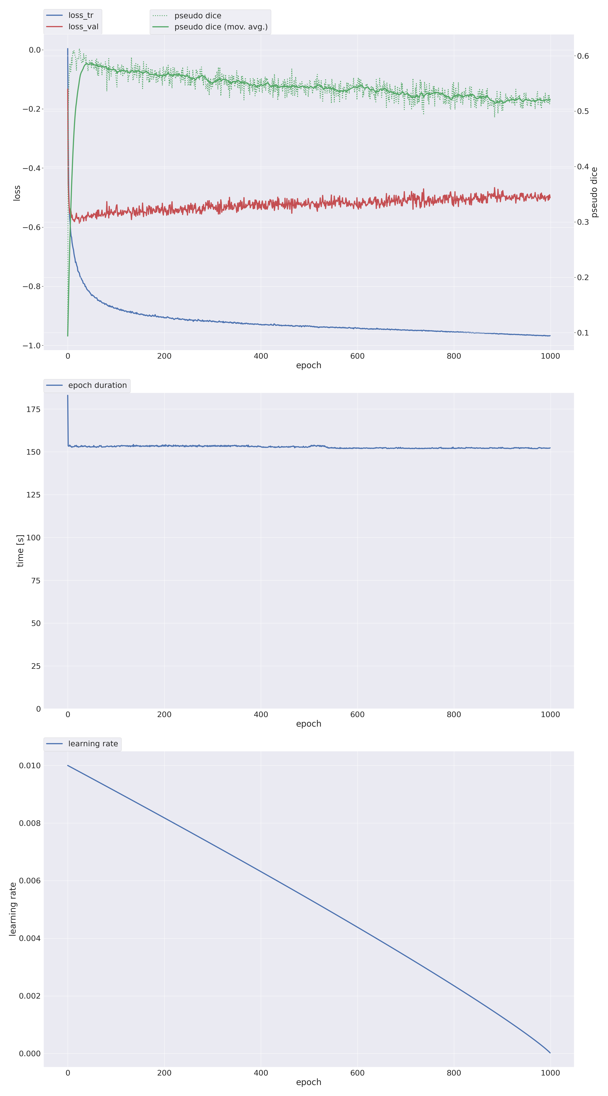
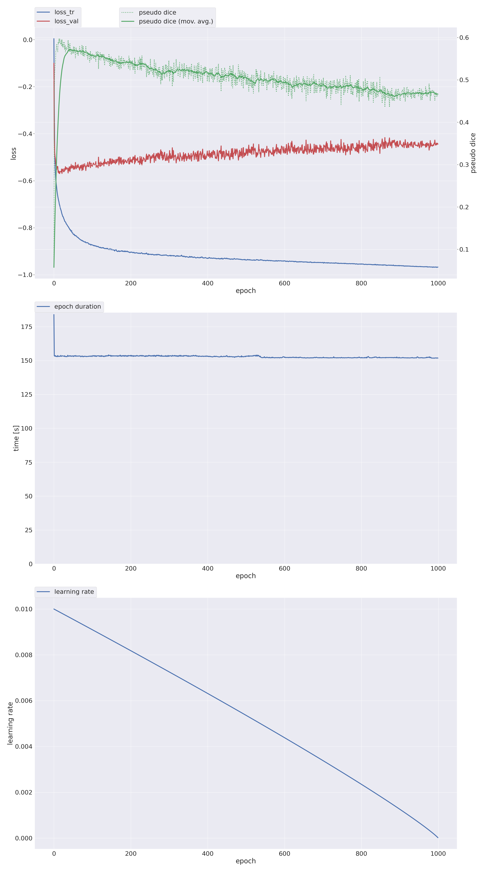
Training curves
Fold_00
Fold_01
2D nnUnet Training:
~ 45 hours
each fold on a GPU: Tesla P100-SXM2-16GB
Fold_02
Fold_03
Fold_04

Slide 8
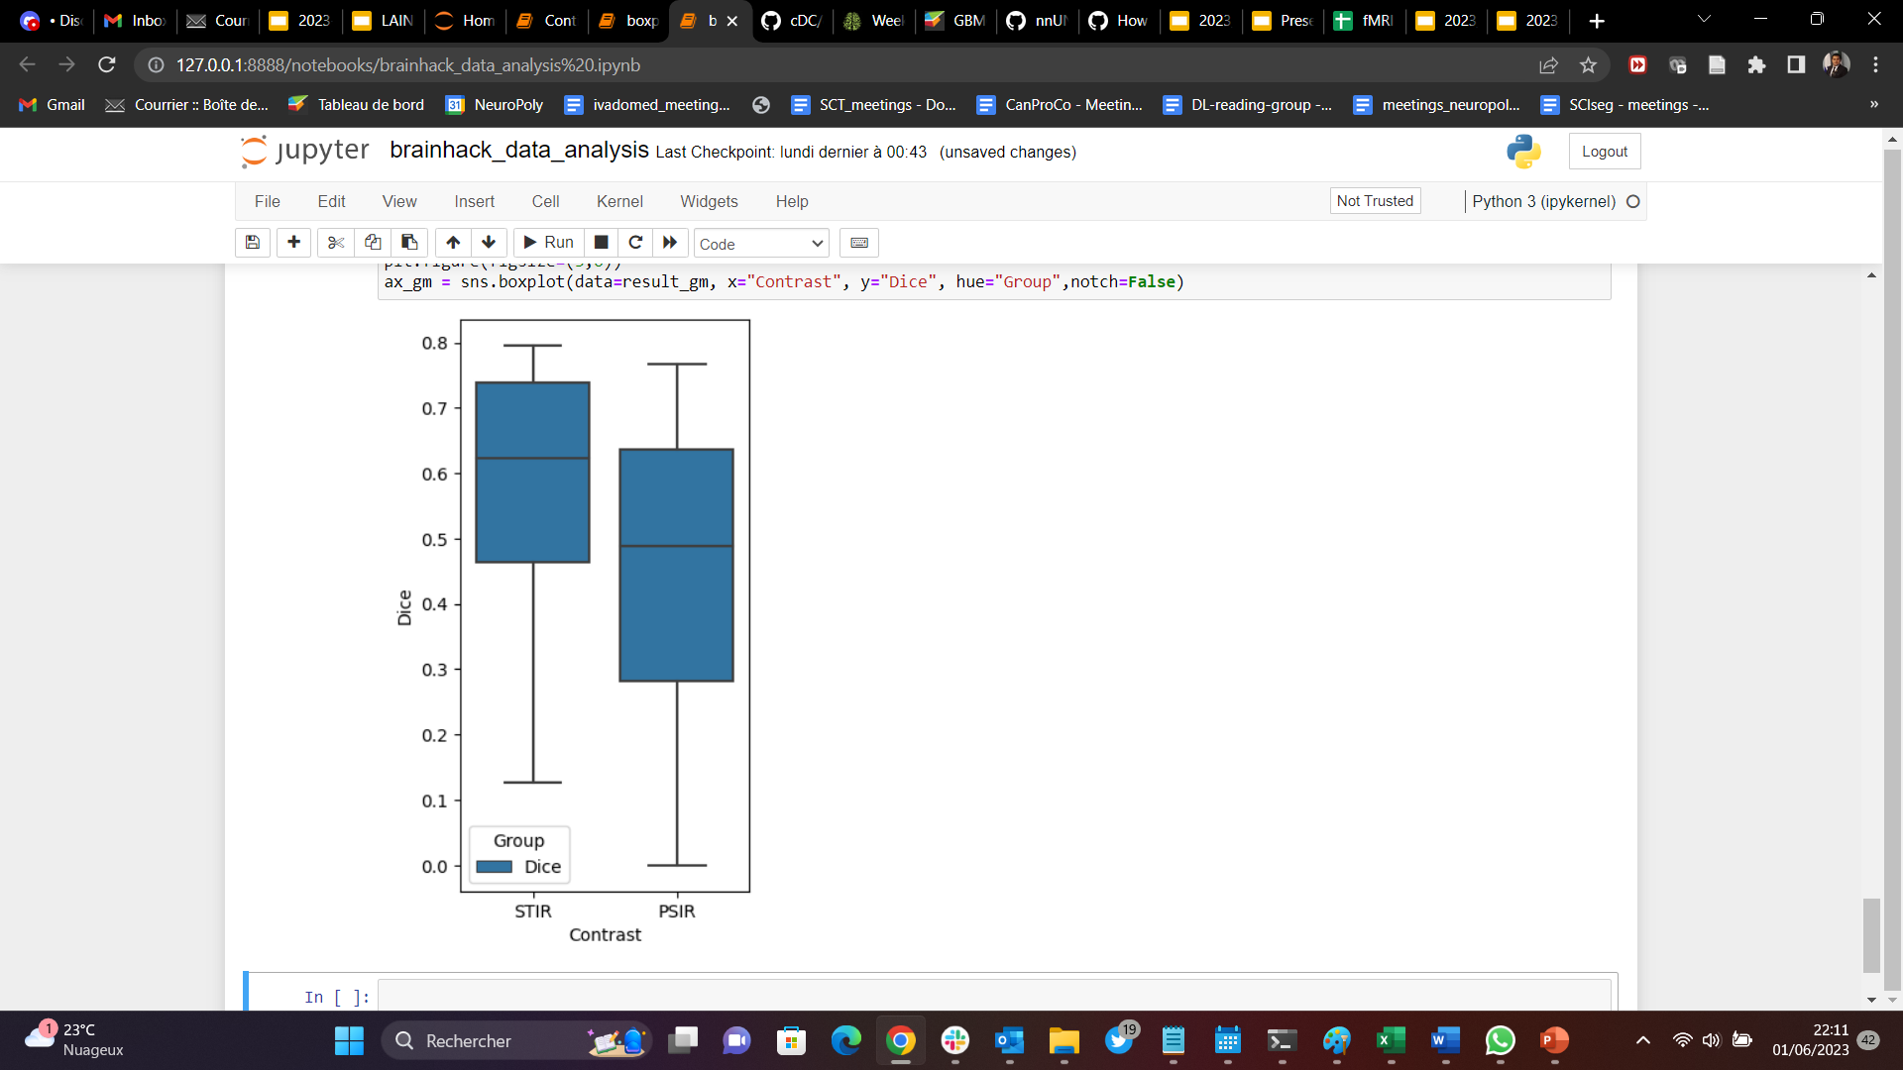
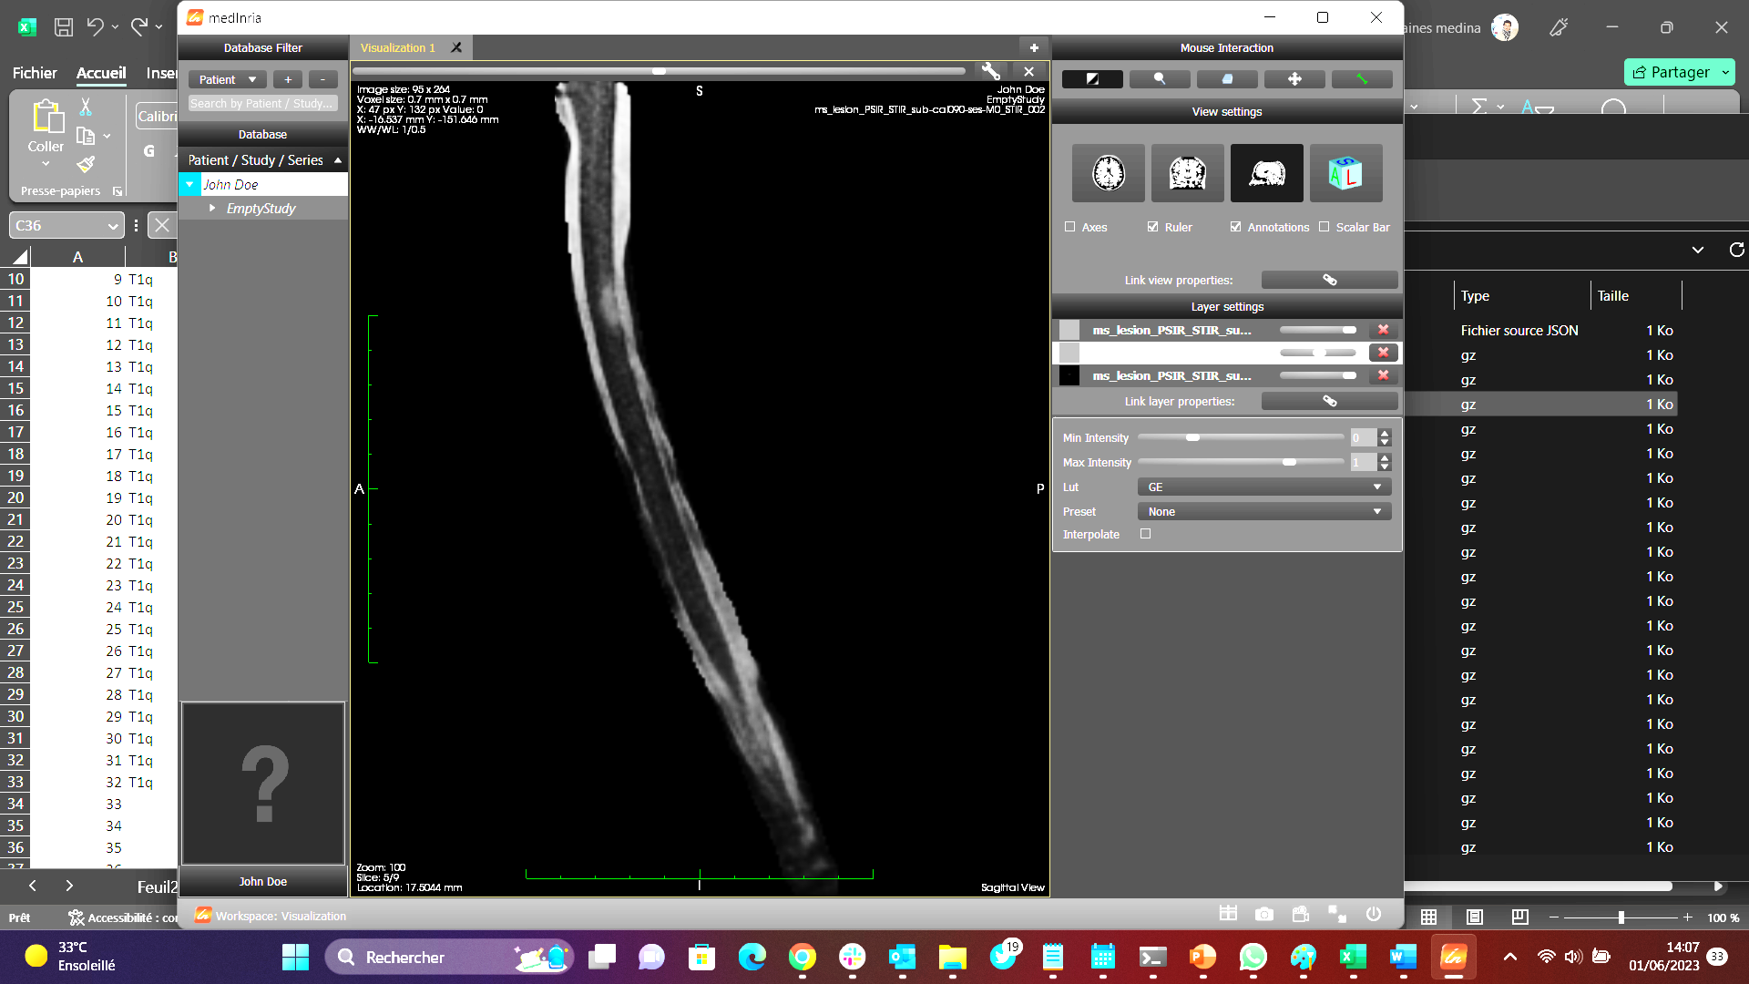
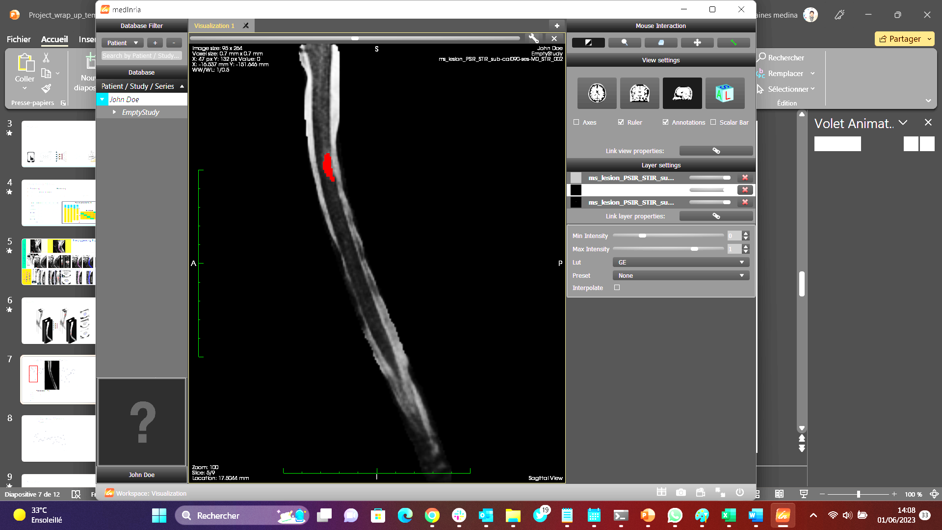
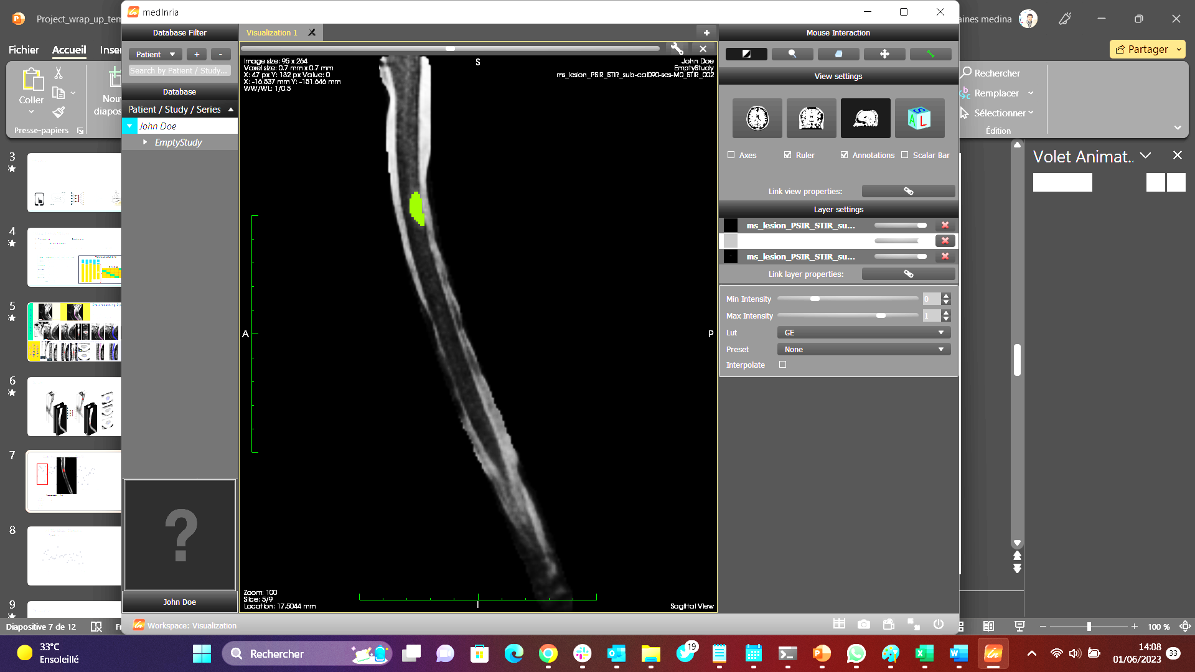
CanProCo Test split (N=79)
STIR PSIR
Dice
On prediction:
Empty mask STIR: 5
Empty mask PSIR: 17
DSC Mean = 0.47 ± 0.18
anat STIR GT nnUnet Model
N | Train/validation | Test
Calgary | 67 | 15
Edmonton | 46 | 13
Montreal | 78 | 16
Toronto | 62 | 18
Vancouver | 61 | 17
Note: there are empty masks on the GT

Slide 9
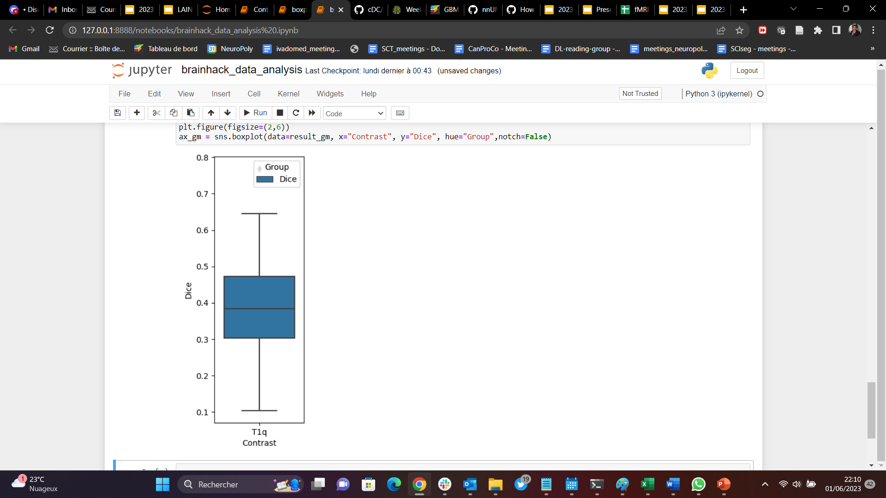
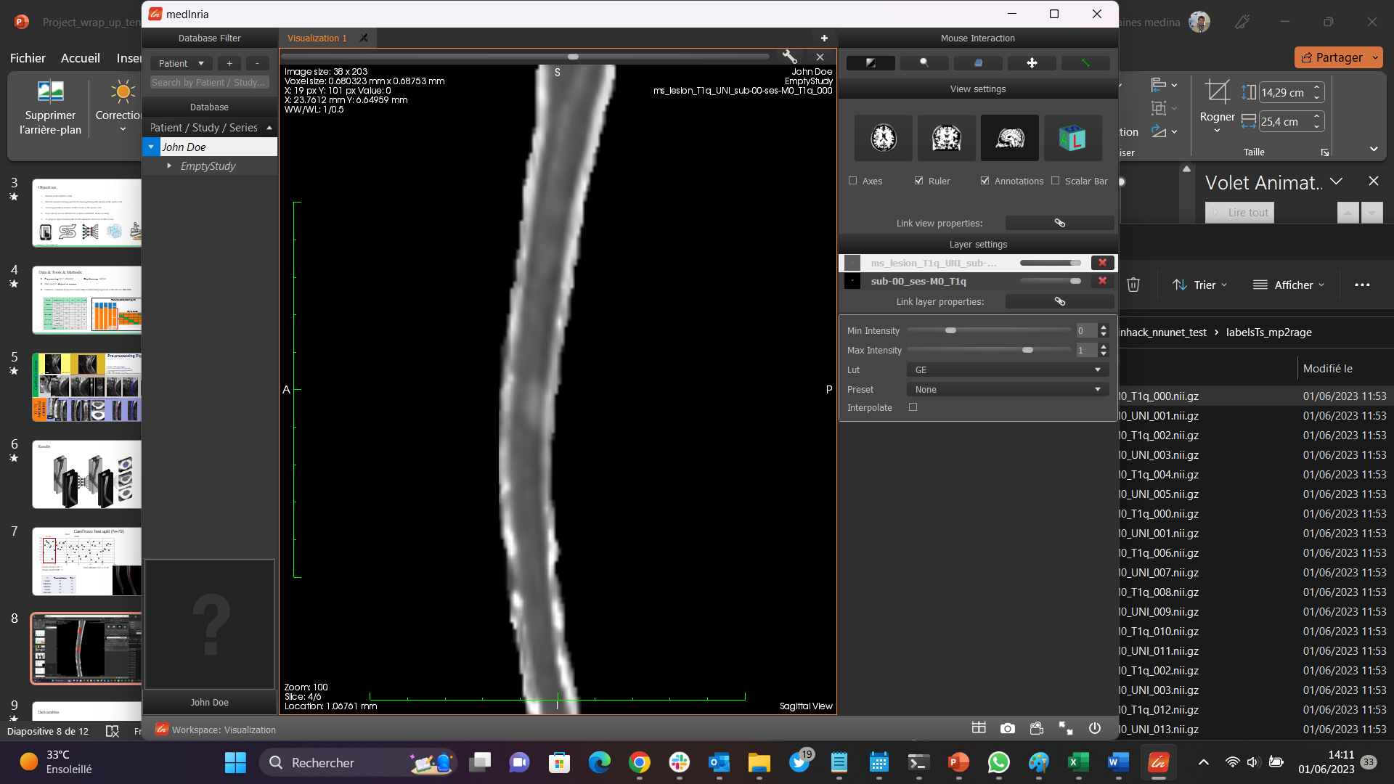
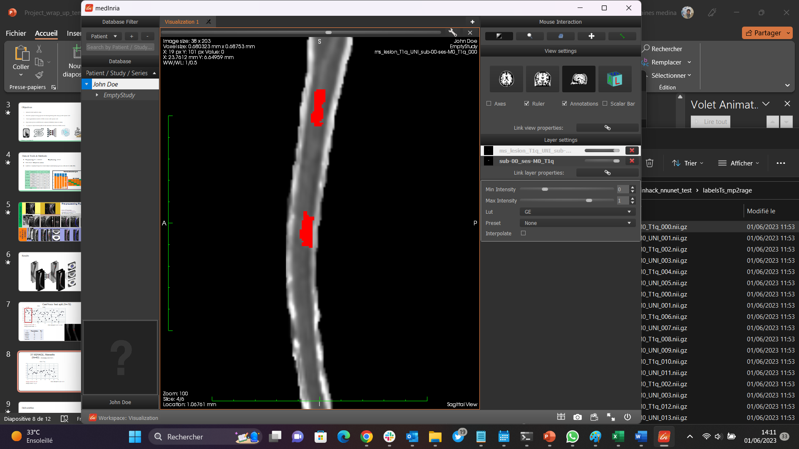
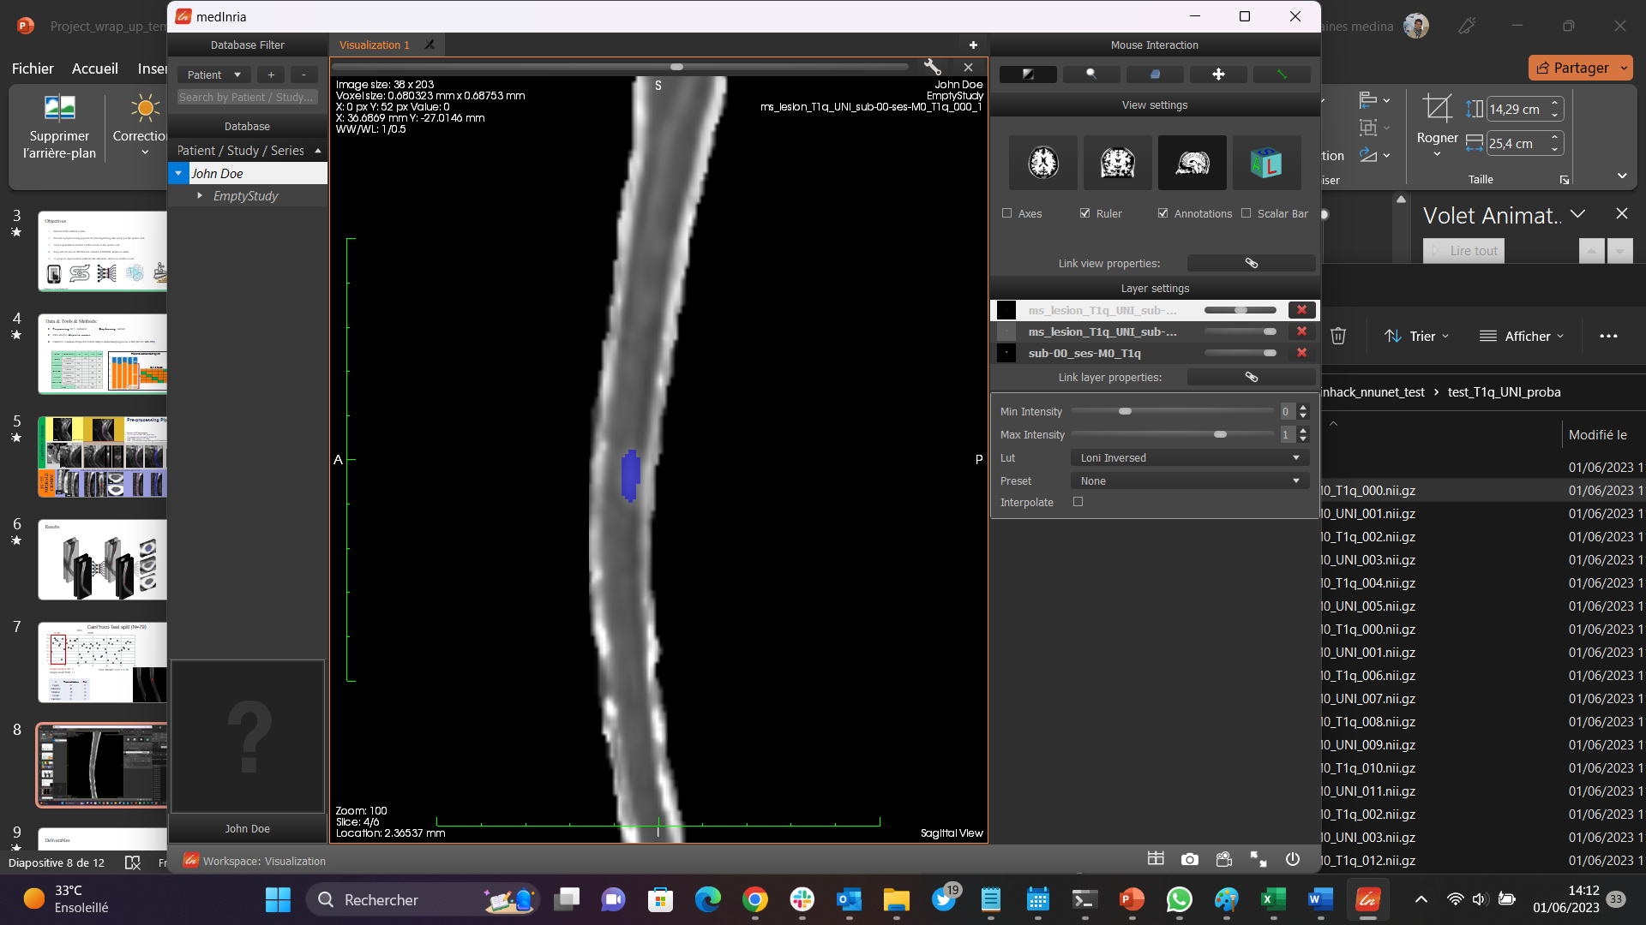
Replicability test: 3T M2RAGE, CRMBM, Marseille (N=40) - Resamplig (3.0x0.7x0.7)
T1q
Dice
Anat T1q GT nnUnet Model
On prediction:
Empty mask UNI: 40
Empty mask T1q: 8
DSC Mean = 0.39 ± 0.1

Slide 10
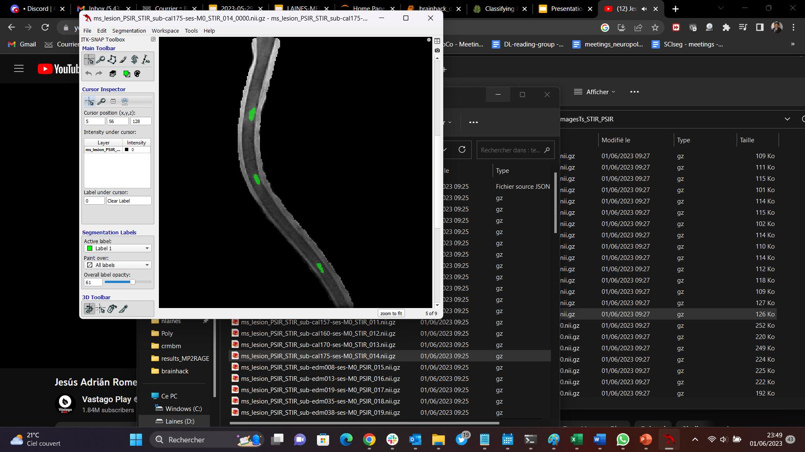
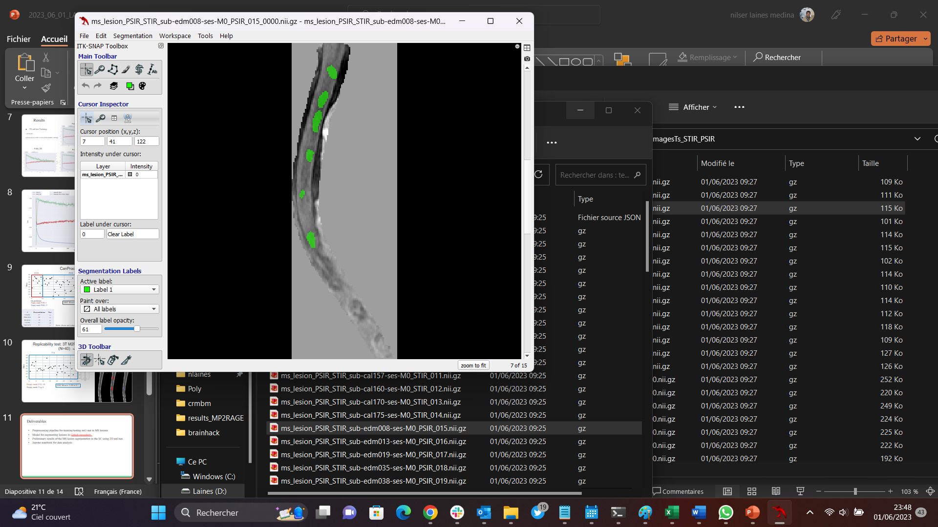
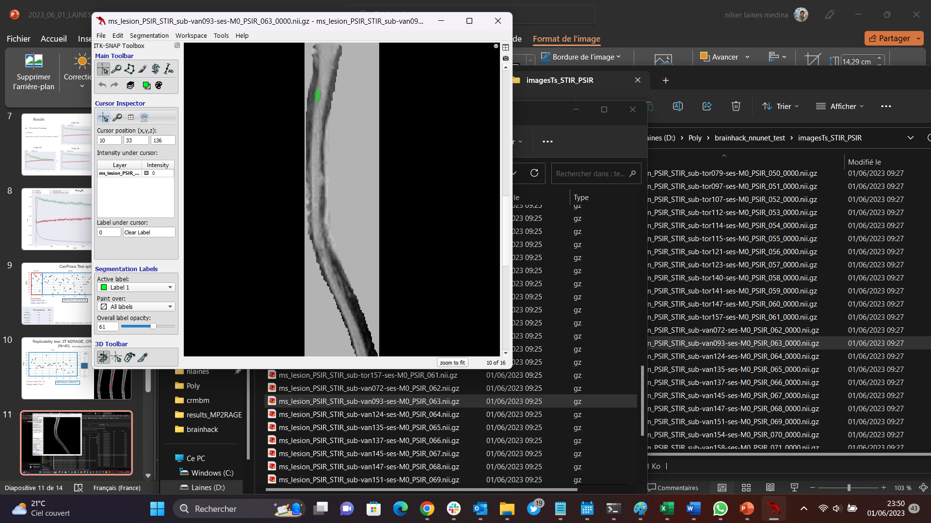
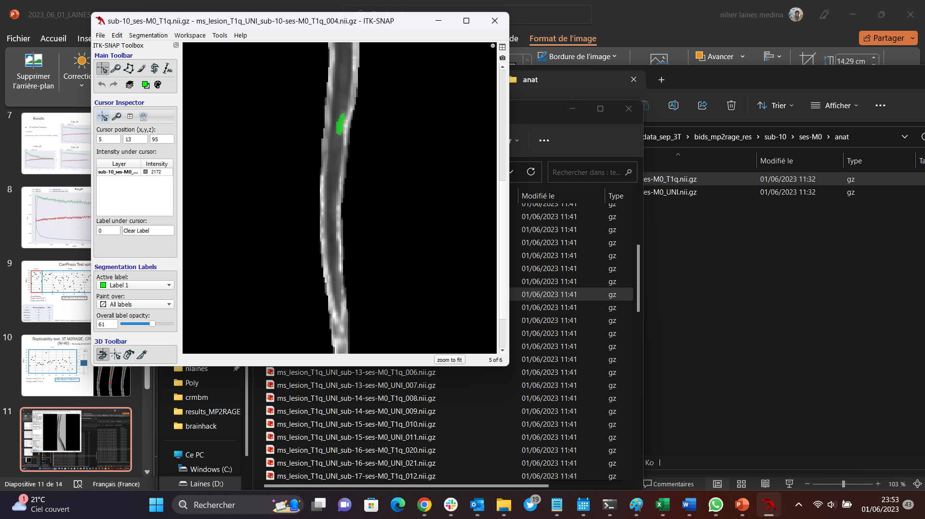
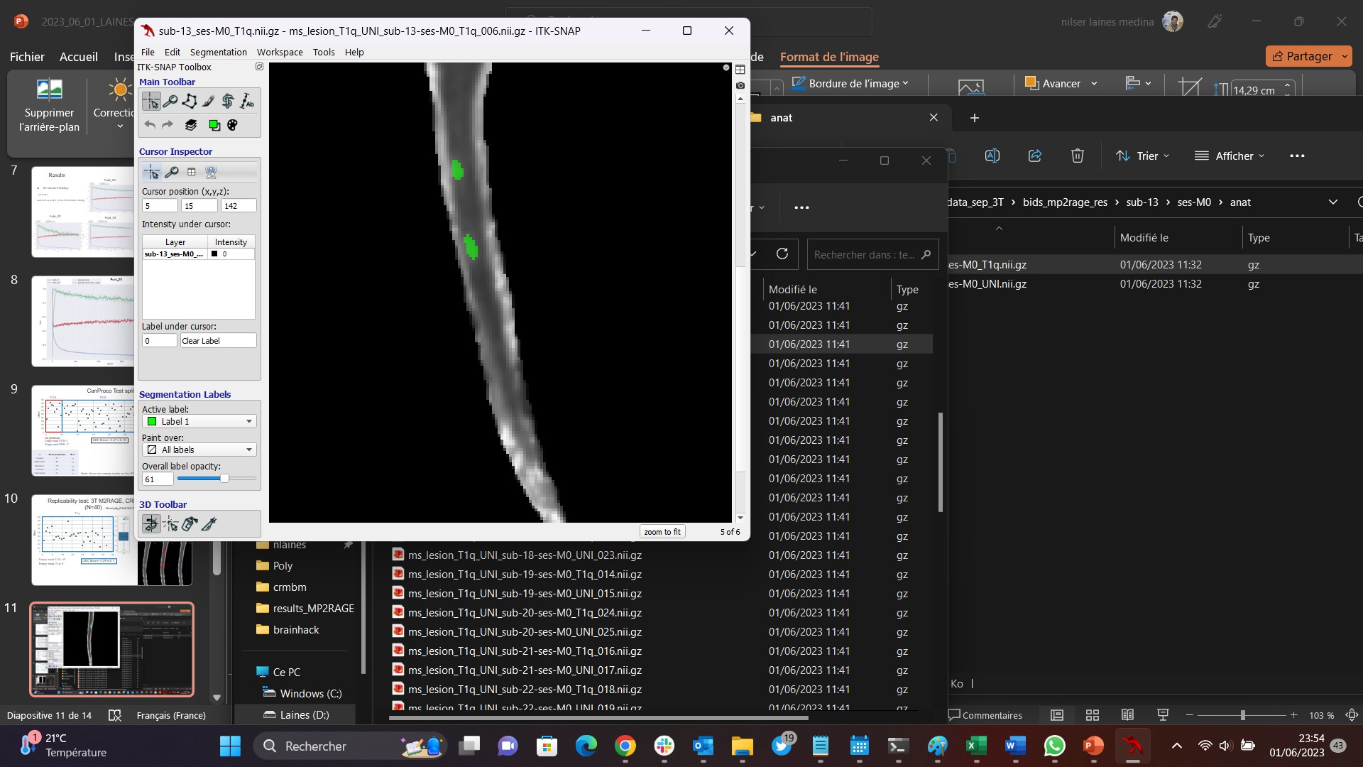
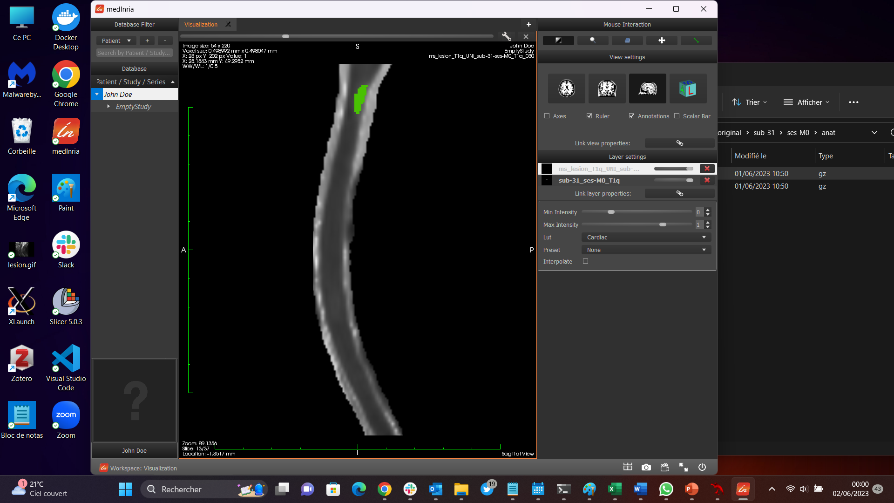
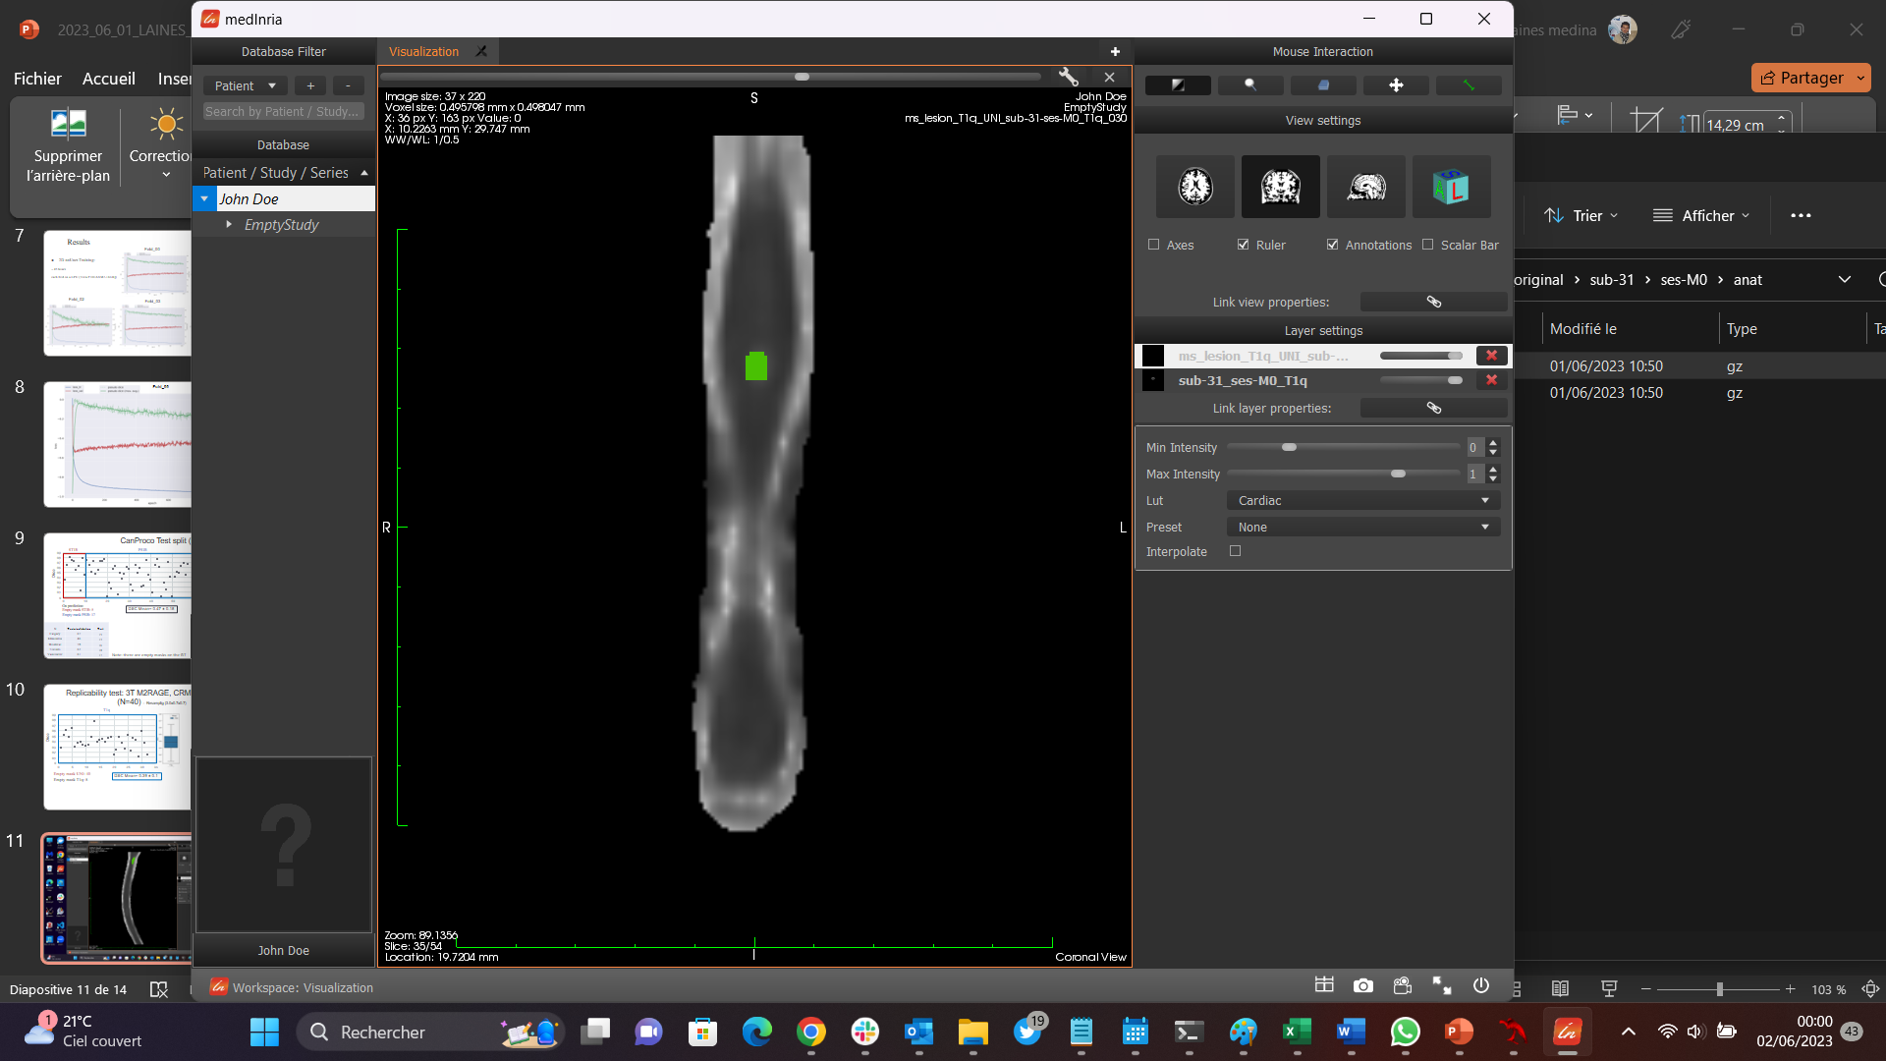
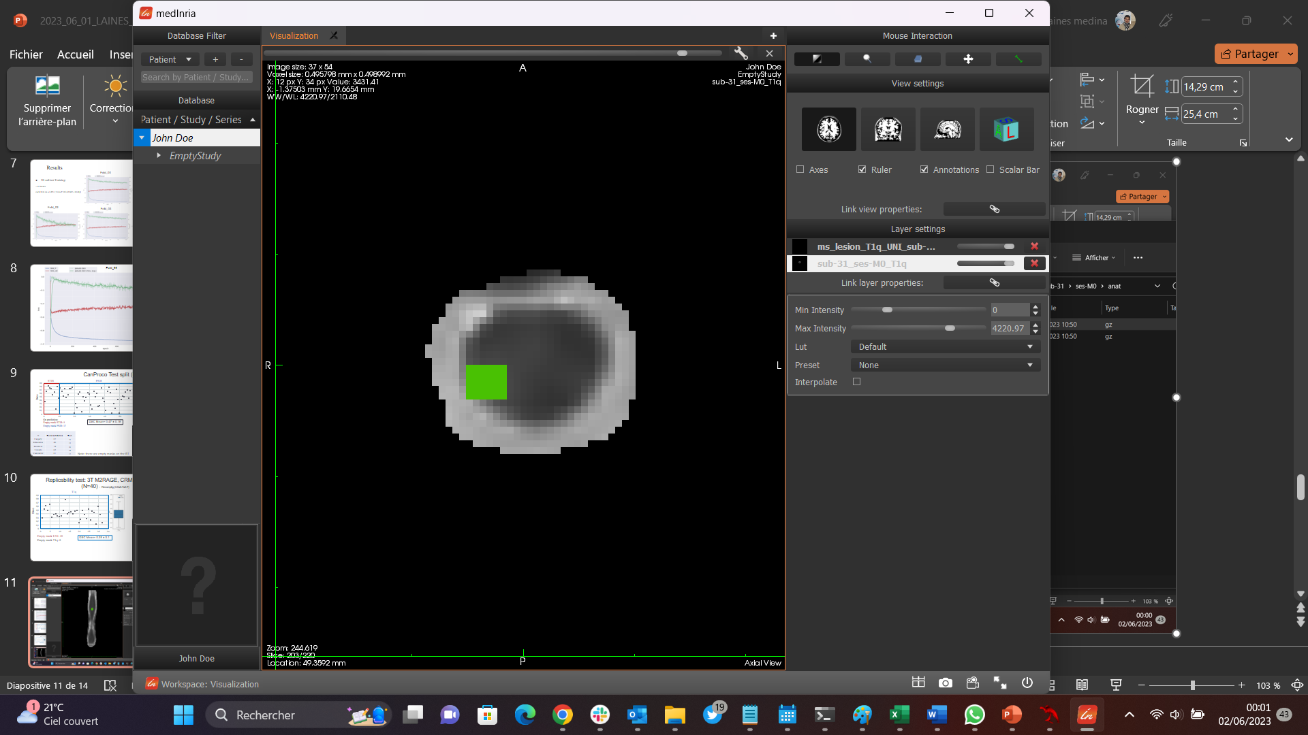
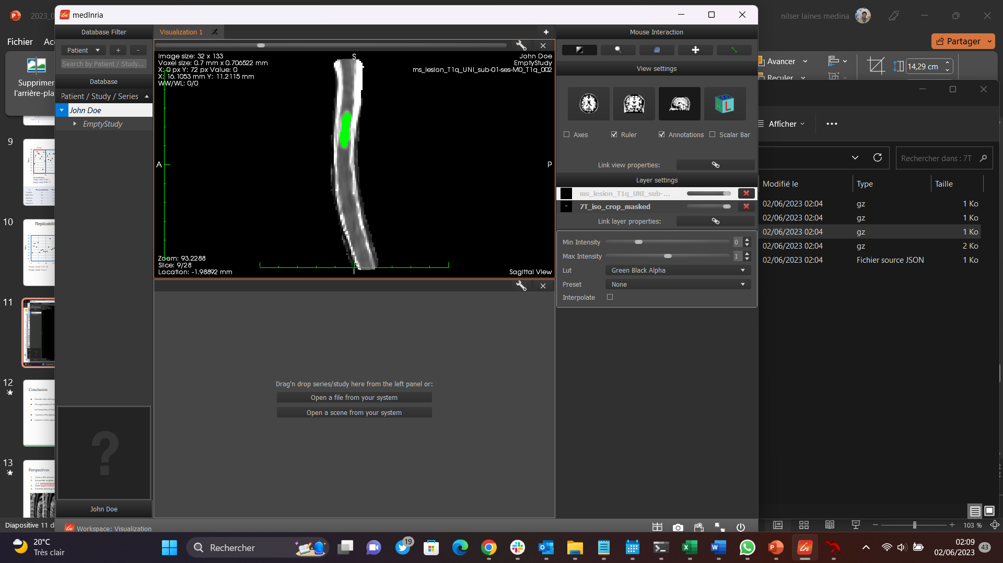
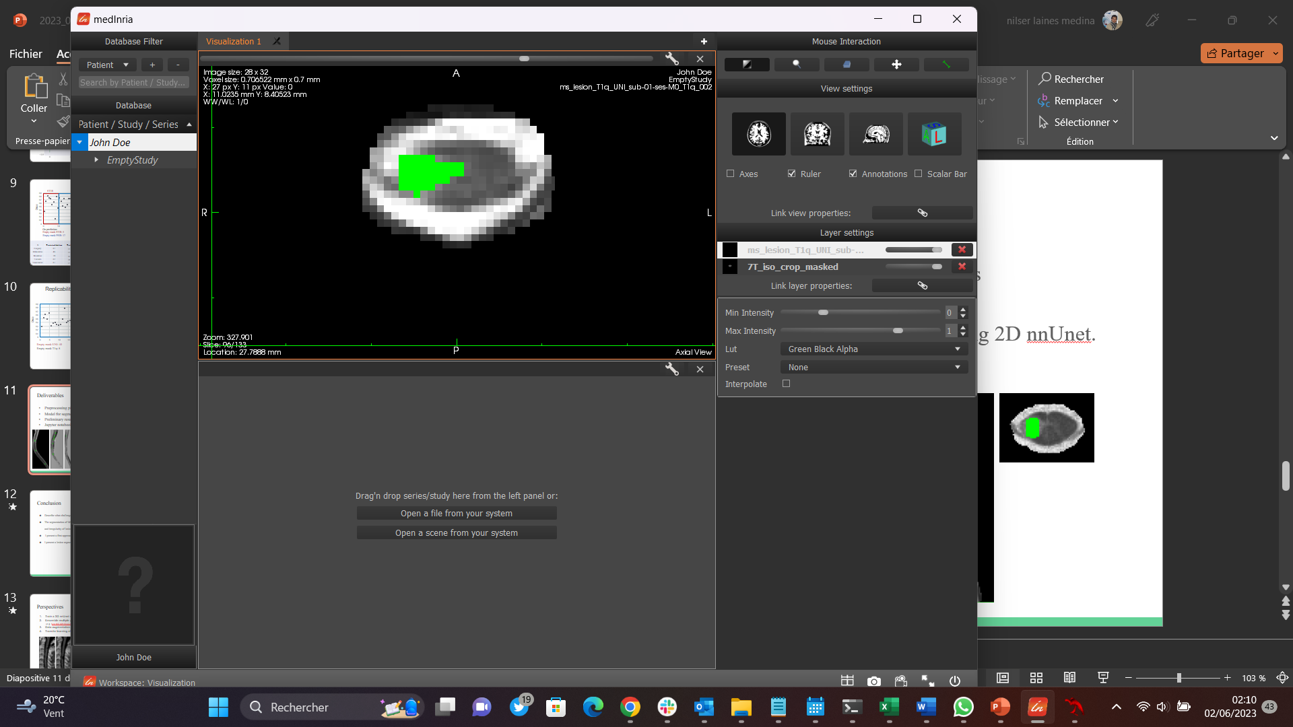
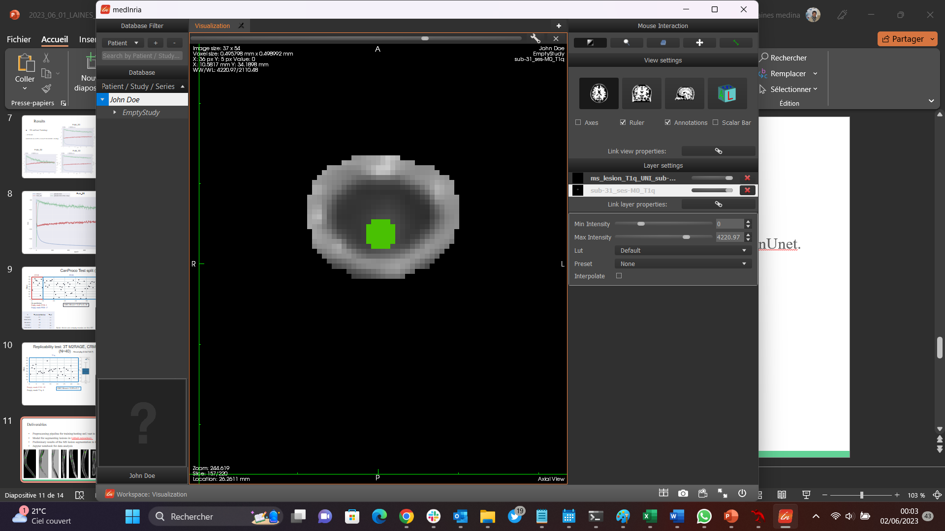
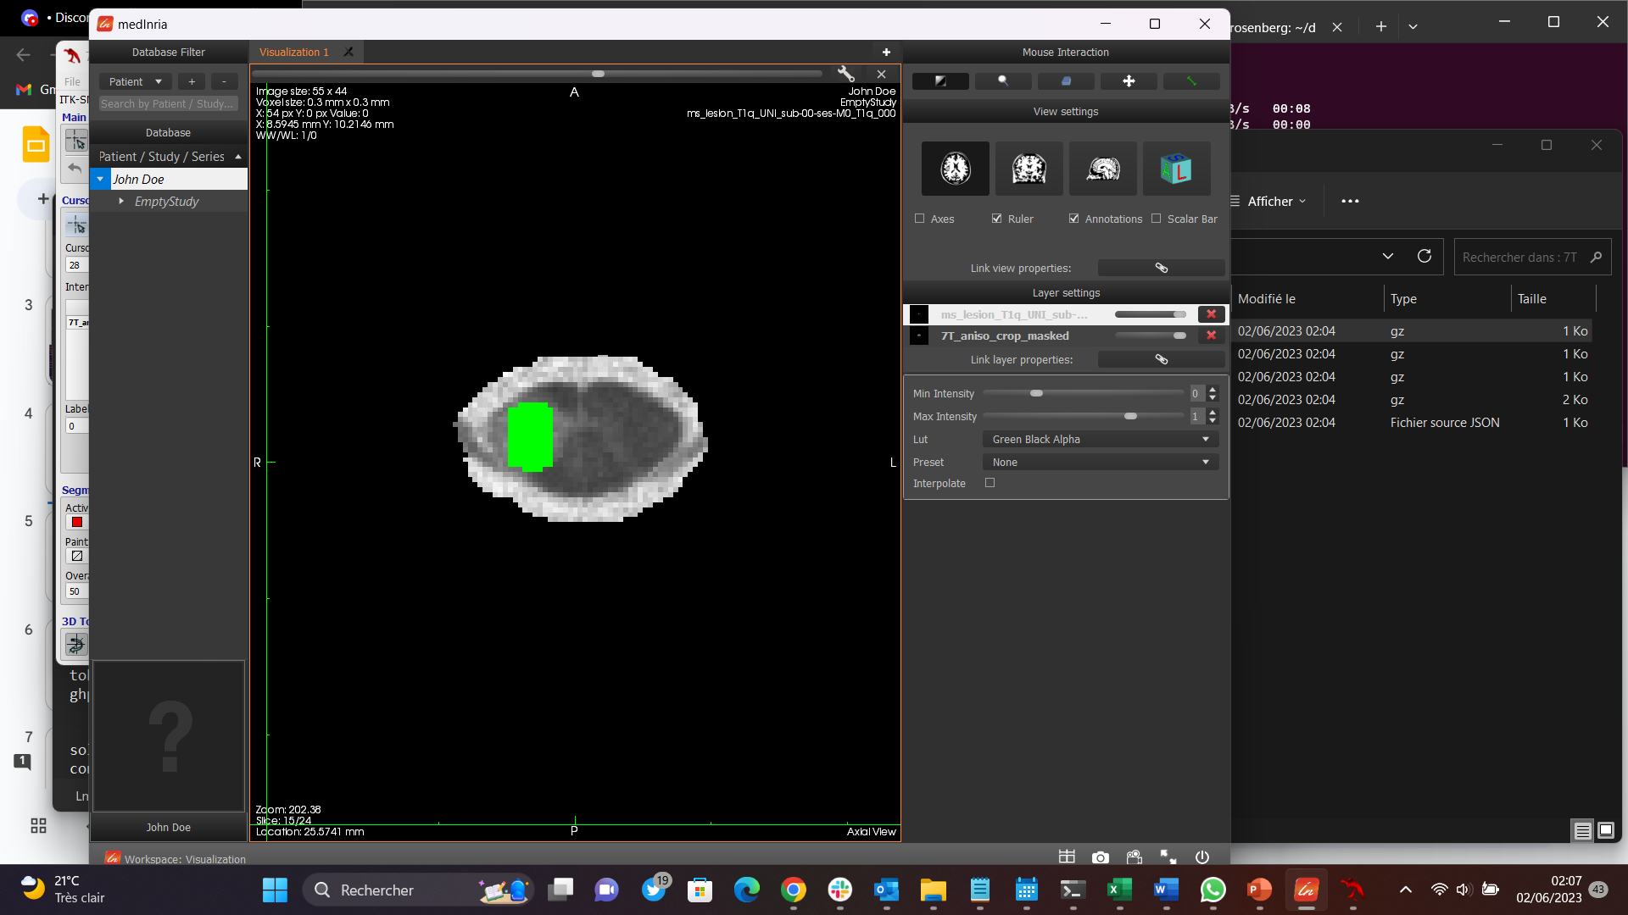


Deliverables
Preprocessing pipeline for training/testing nnU-net in MS lesions
Model for segmenting lesions in Github repository
Preliminary results of the MS lesion segmentation in the SC using 2D nnUnet.
Jupyter notebook for data analysis
STIR/PSIR
3T MP2RAGE
7T MP2RAGE

Slide 11
Conclusion
The segmentation of MS lesions in the spinal cord is a challenge:
there is no segmentation model that works "right" in MS lesions
it is linked to inter-rater bias, small volume and irregularity of lesions.
First approach (2D nnUnet) trained on STIR/PSIR and a replicability test on MP2RAGE data.
Automatic deep learning lesion segmentation models is a work in progress.
11

Slide 12




Perspectives
Train a 3D nnUnet models
Ensemble multiple predictions approaches
(e.g. Seg MS MP2RAGE model from Basel)
3. Data augmentation methods (GAN; Diffusion models)
4. Transfer learning of our model to other trainings
PSIR
/
STIR
Other contrasts
TL
12

Slide 13
References
A. J. Thompson et al., ‘Diagnosis of multiple sclerosis: 2017 revisions of the McDonald criteria’, Lancet Neurol., vol. 17, no. 2, pp. 162–173, Feb. 2018, doi: 10.1016/S1474-4422(17)30470-2.
B. De Leener et al., ‘SCT: Spinal Cord Toolbox, an open-source software for processing spinal cord MRI data’, NeuroImage, vol. 145, pp. 24–43, Jan. 2017, doi: 10.1016/j.neuroimage.2016.10.009.
C. Gros et al., ‘Automatic segmentation of the spinal cord and intramedullary multiple sclerosis lesions with convolutional neural networks’, NeuroImage, vol. 184, pp. 901–915, Jan. 2019, doi: 10.1016/j.neuroimage.2018.09.081.
O. Vincent, C. Gros, J. P. Cohen, and J. Cohen-Adad, ‘Automatic segmentation of spinal multiple sclerosis lesions: How to generalize across MRI contrasts?’, ArXiv200304377 Cs Eess, Jun. 2020, Accessed: May 25, 2022. [Online]. Available: http://arxiv.org/abs/2003.04377
H. Lassmann, ‘Multiple Sclerosis Pathology’, Cold Spring Harb. Perspect. Med., vol. 8, no. 3, Mar. 2018, doi: 10.1101/cshperspect.a028936.
O. Ronneberger, P. Fischer, and T. Brox, ‘U-Net: Convolutional Networks for Biomedical Image Segmentation’. arXiv, May 18, 2015. doi: 10.48550/arXiv.1505.04597.
Ö. Çiçek, A. Abdulkadir, S. S. Lienkamp, T. Brox, and O. Ronneberger, ‘3D U-Net: Learning Dense Volumetric Segmentation from Sparse Annotation’. arXiv, Jun. 21, 2016. Accessed: Jun. 30, 2022. [Online]. Available: http://arxiv.org/abs/1606.06650
Oh, J., Arbour, N., Giuliani, F., Guenette, M., Kolind, S., Lynd, L., Marrie, R. A., Metz, L. M., Patten, S. B., Prat, A., Schabas, A., Smyth, P., Tam, R., Traboulsee, A., & Yong, V. W. (2021). The Canadian prospective cohort study to understand progression in multiple sclerosis (CanProCo): Rationale, aims, and study design. BMC Neurology, 21(1), 418. https://doi.org/10.1186/s12883-021-02447-7
Sastre-Garriga, J., Pareto, D., Alberich, M., Rodríguez-Acevedo, B., Vidal-Jordana, À., Corral, J. F., Tintoré, M., Río, J., Auger, C., Montalban, X., & Rovira, À. (2022). Spinal cord grey matter atrophy in Multiple Sclerosis clinical practice. Neuroscience Informatics, 2(2), 100071. https://doi.org/10.1016/j.neuri.2022.100071

